Slide 1
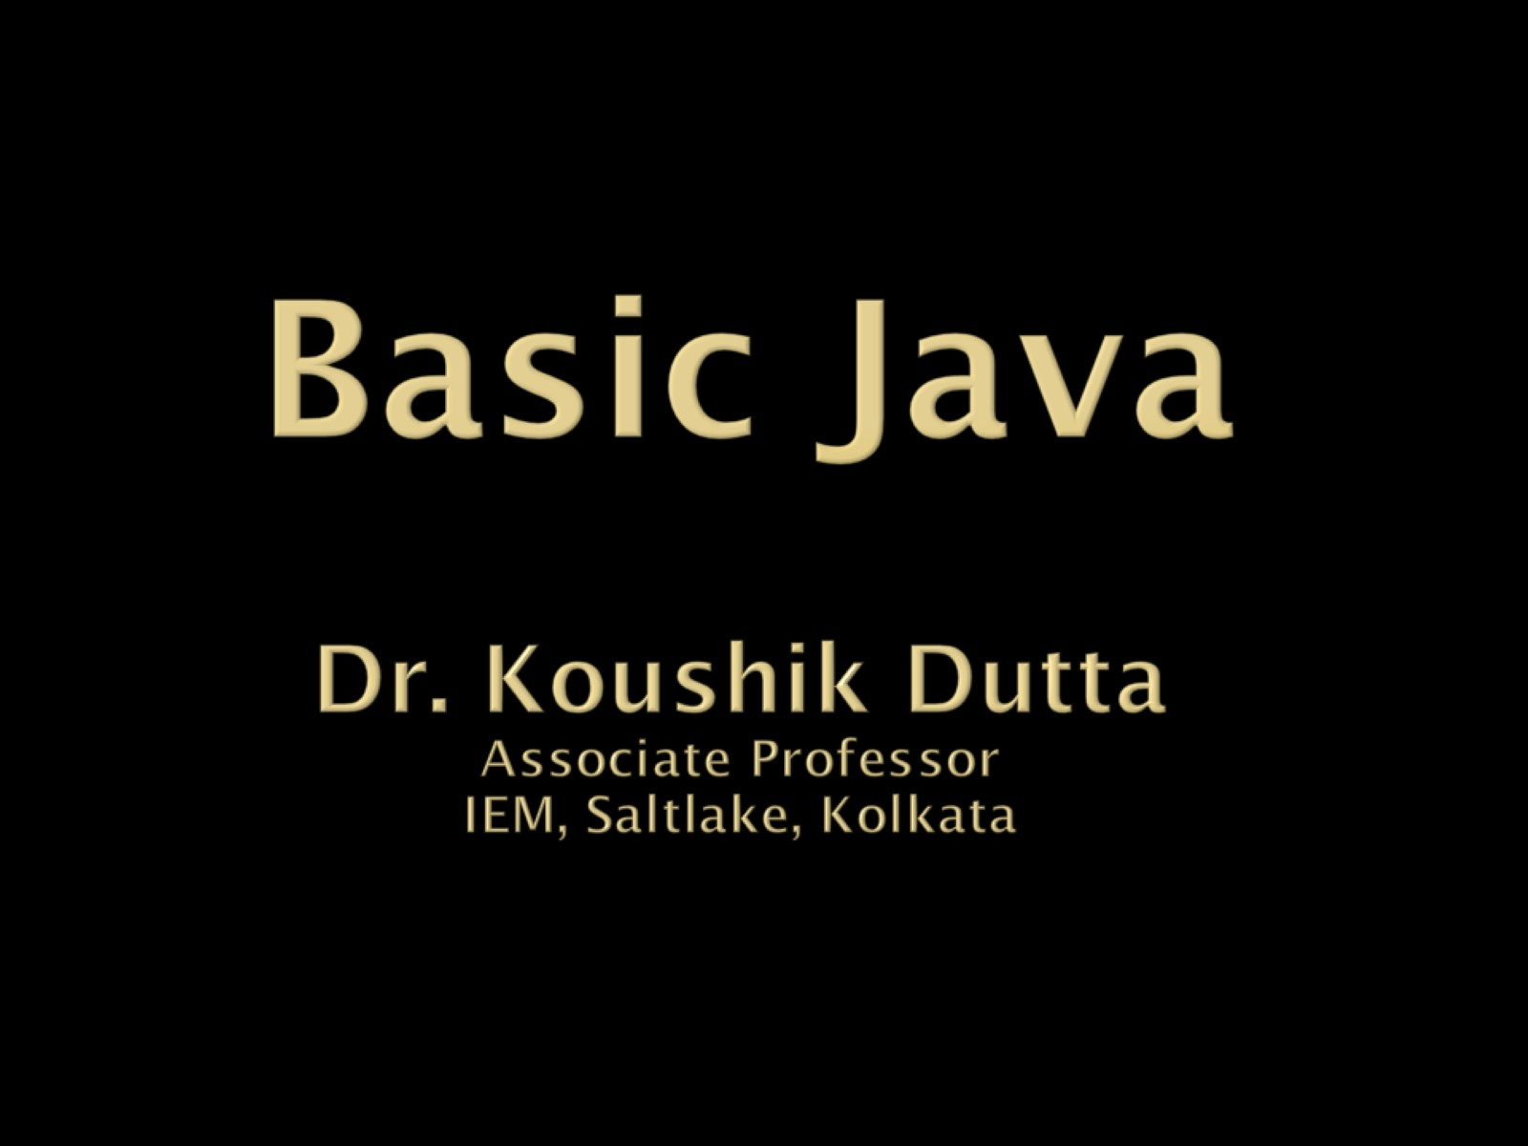
Basic Java

Slide 2
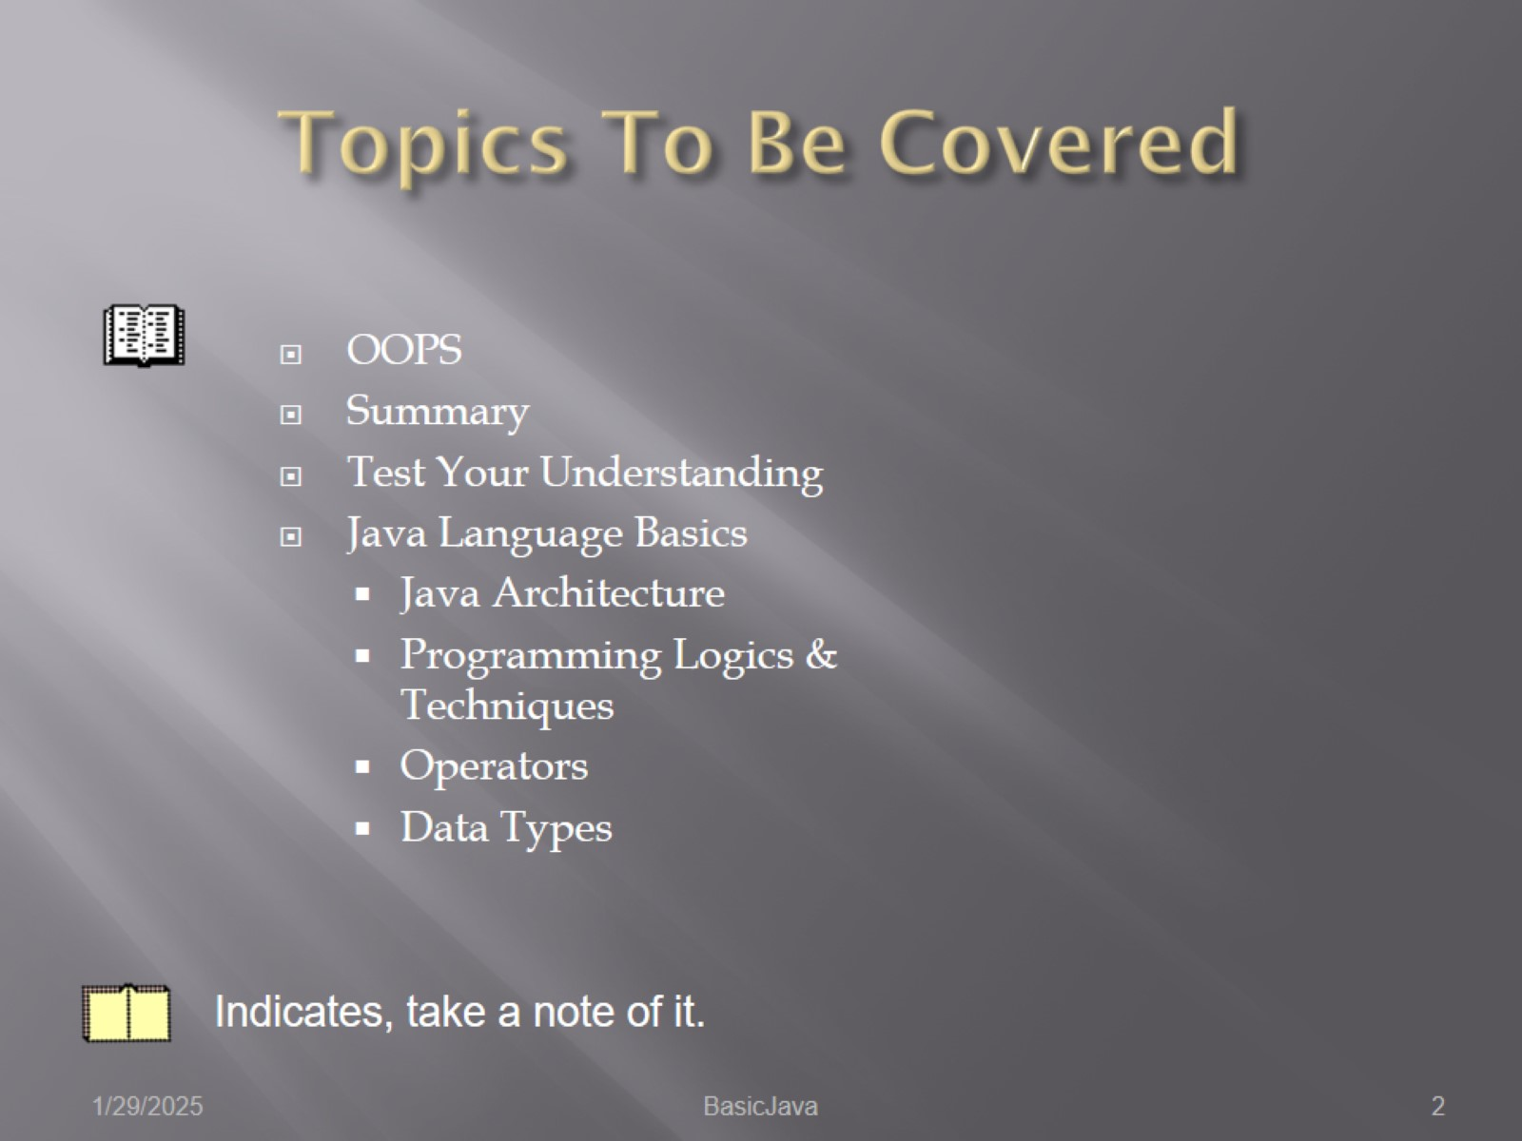
Topics To Be Covered

Slide 3

OOPS

Slide 4
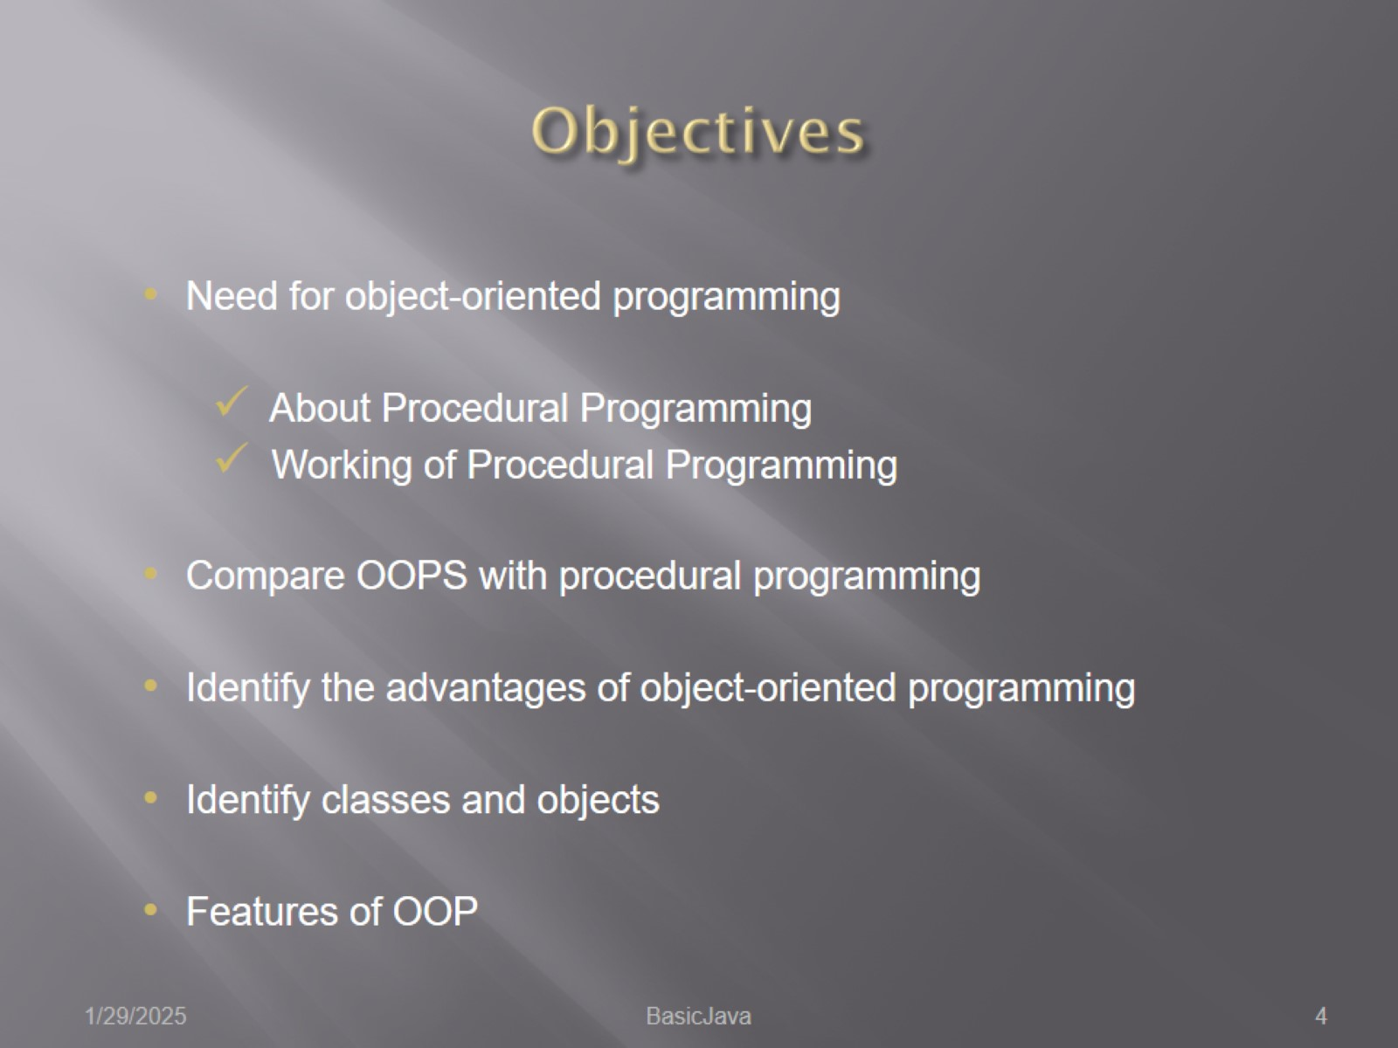
Objectives

Slide 5
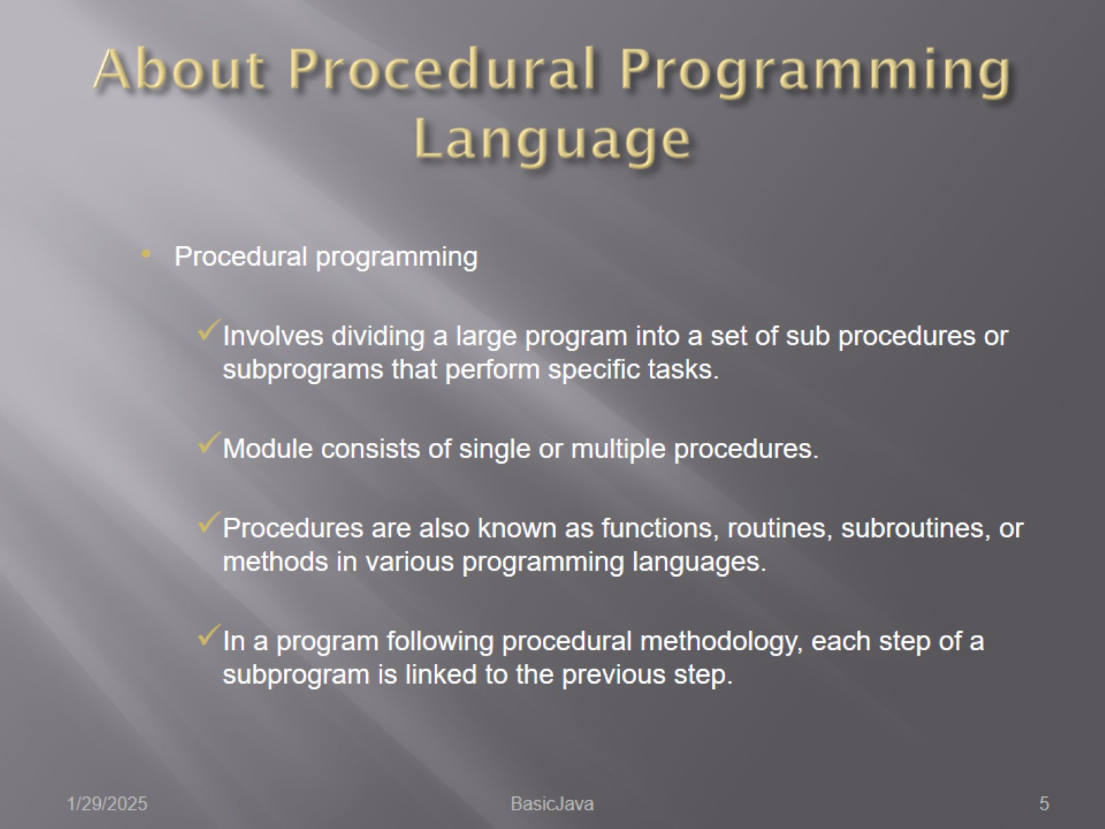
About Procedural Programming Language

Slide 6
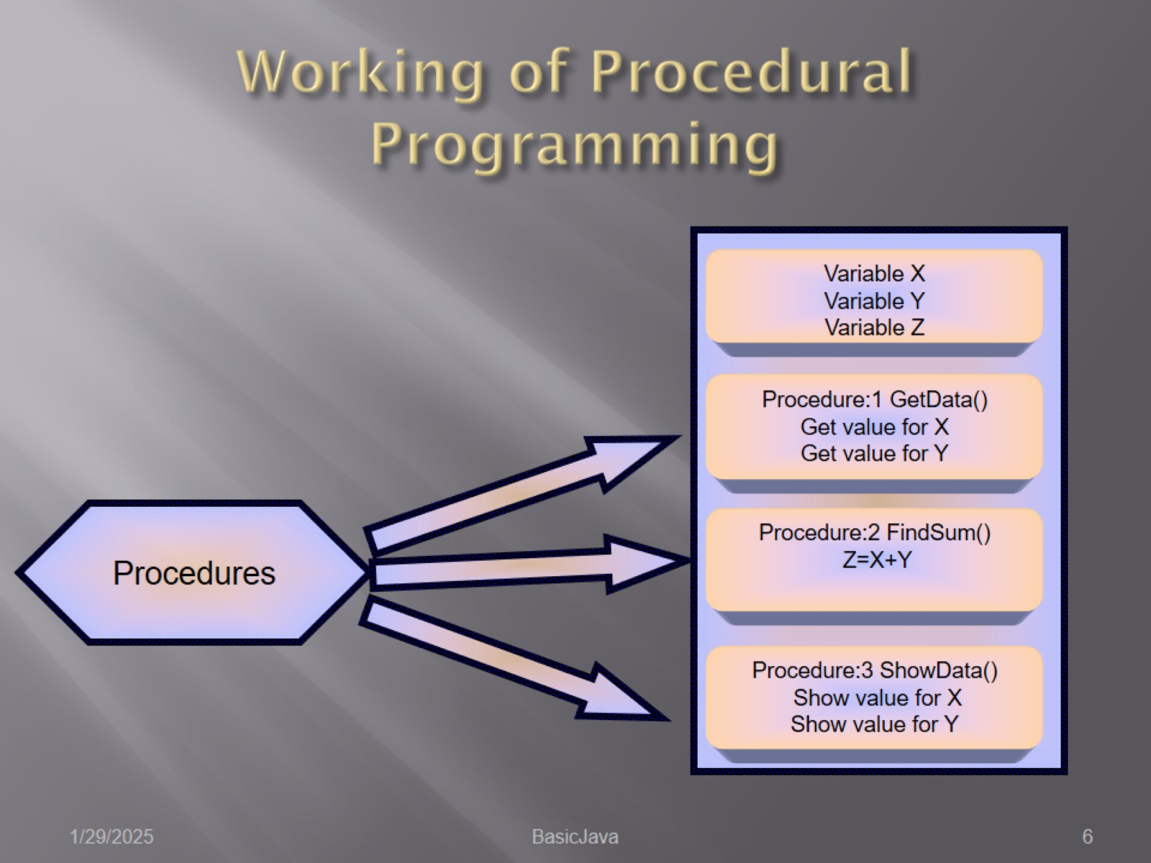
Working of Procedural Programming

Slide 7
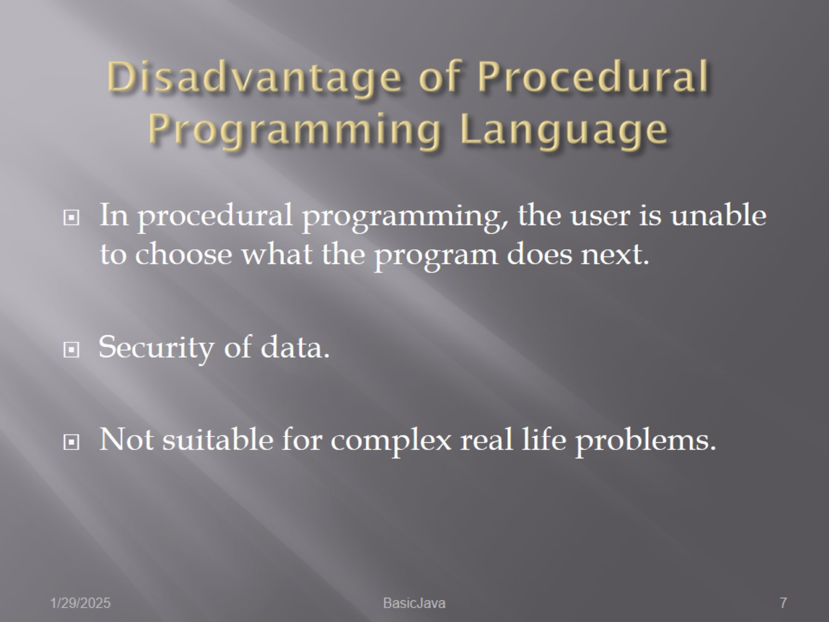
Disadvantage of Procedural Programming Language

Slide 8
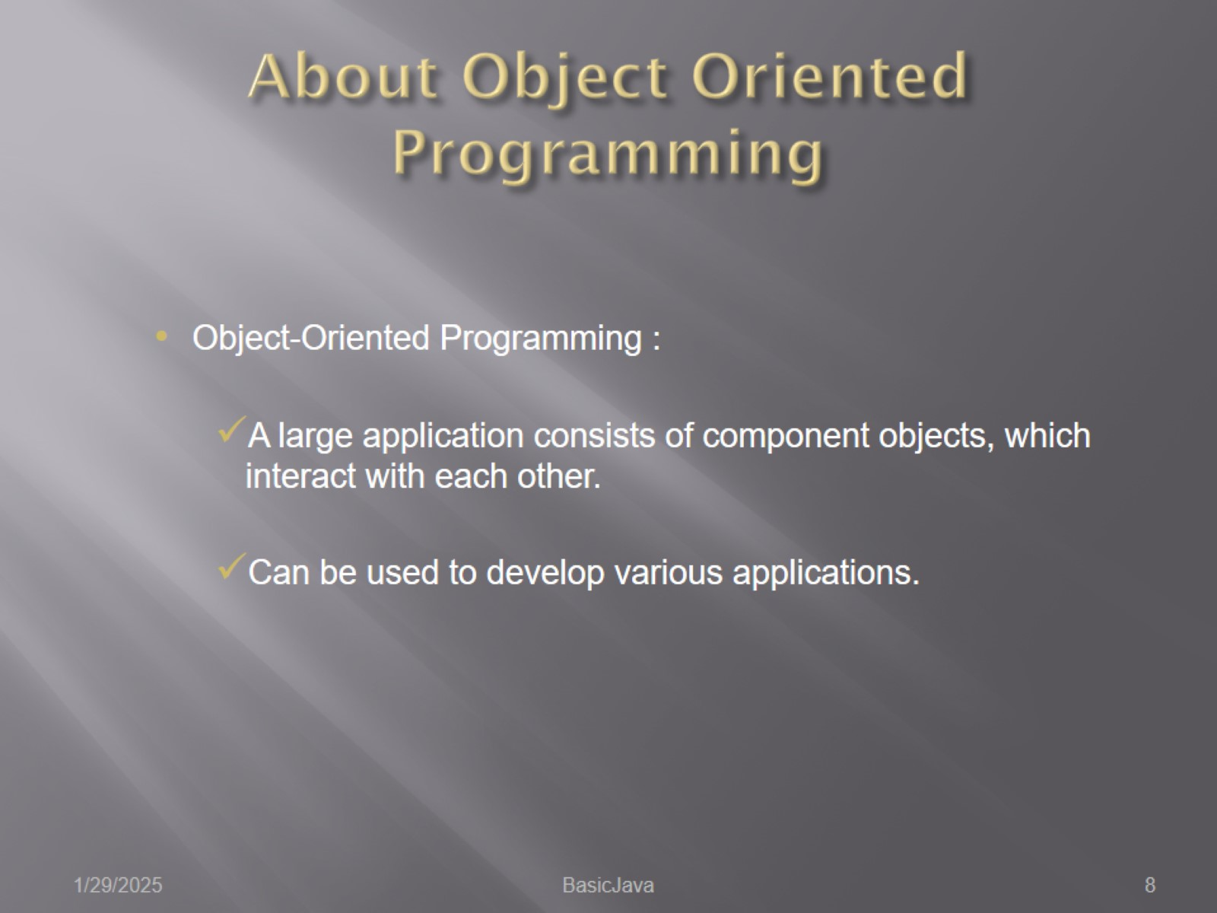
About Object Oriented Programming

Slide 9
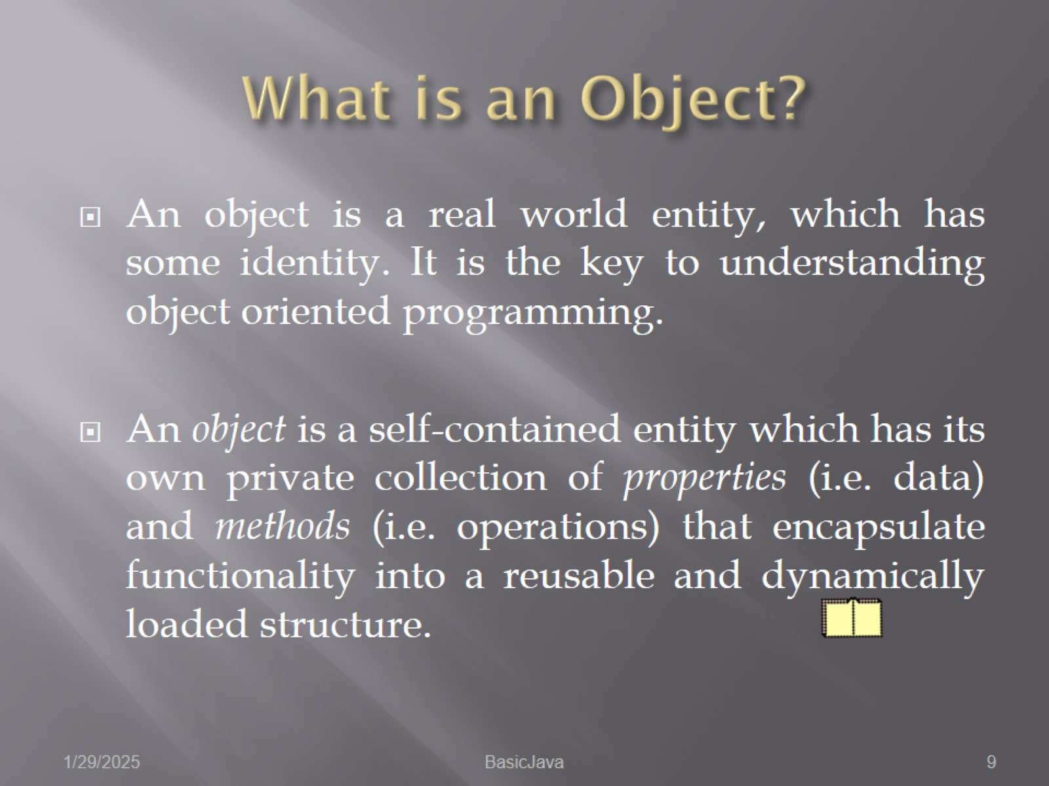
What is an Object?

Slide 10
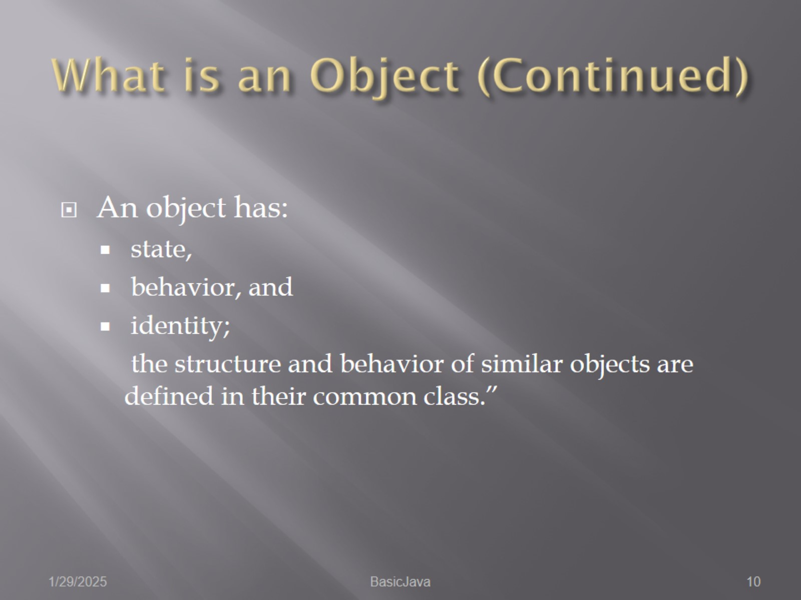
What is an Object (Continued)

Slide 11
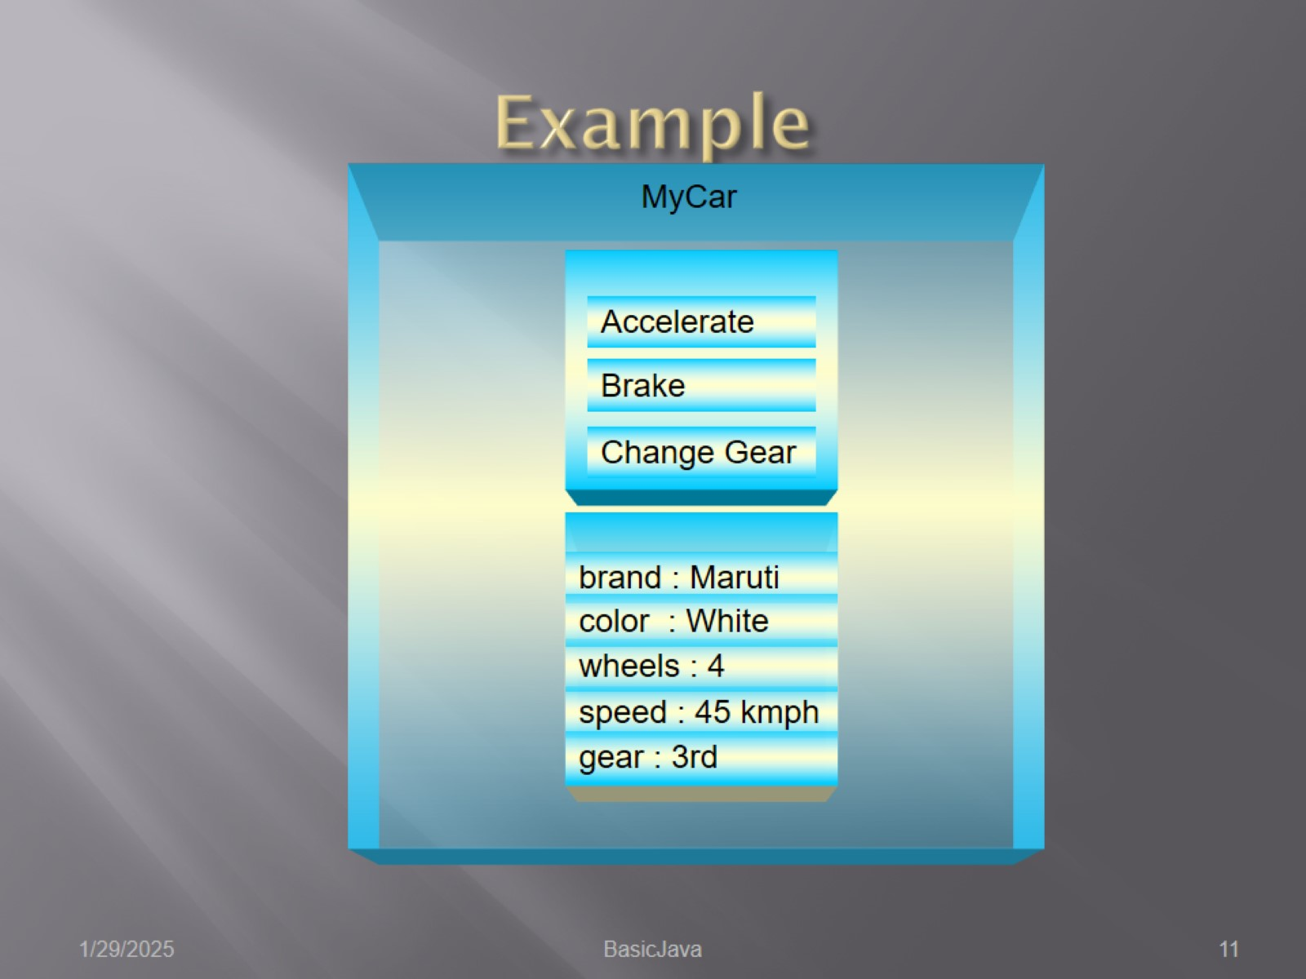
Example

Slide 12
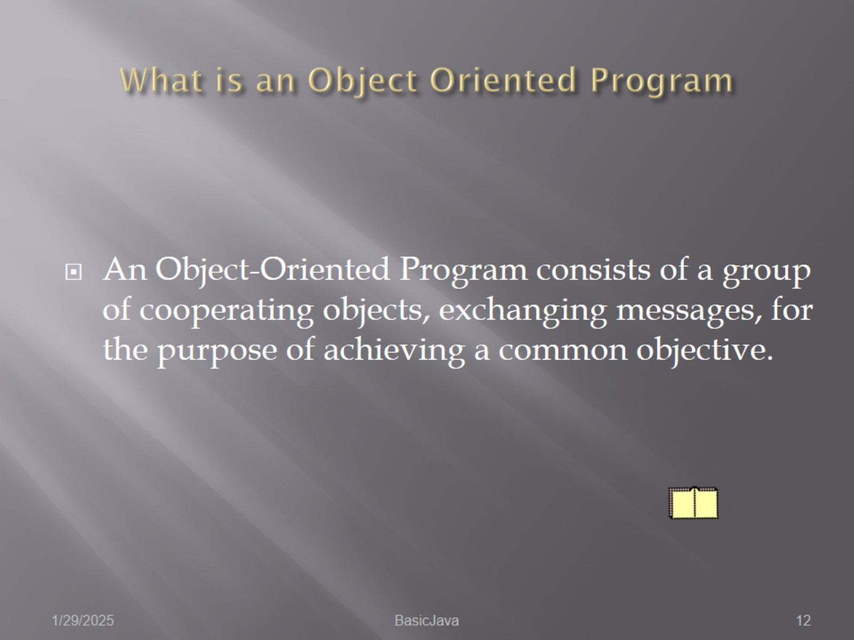
What is an Object Oriented Program

Slide 13
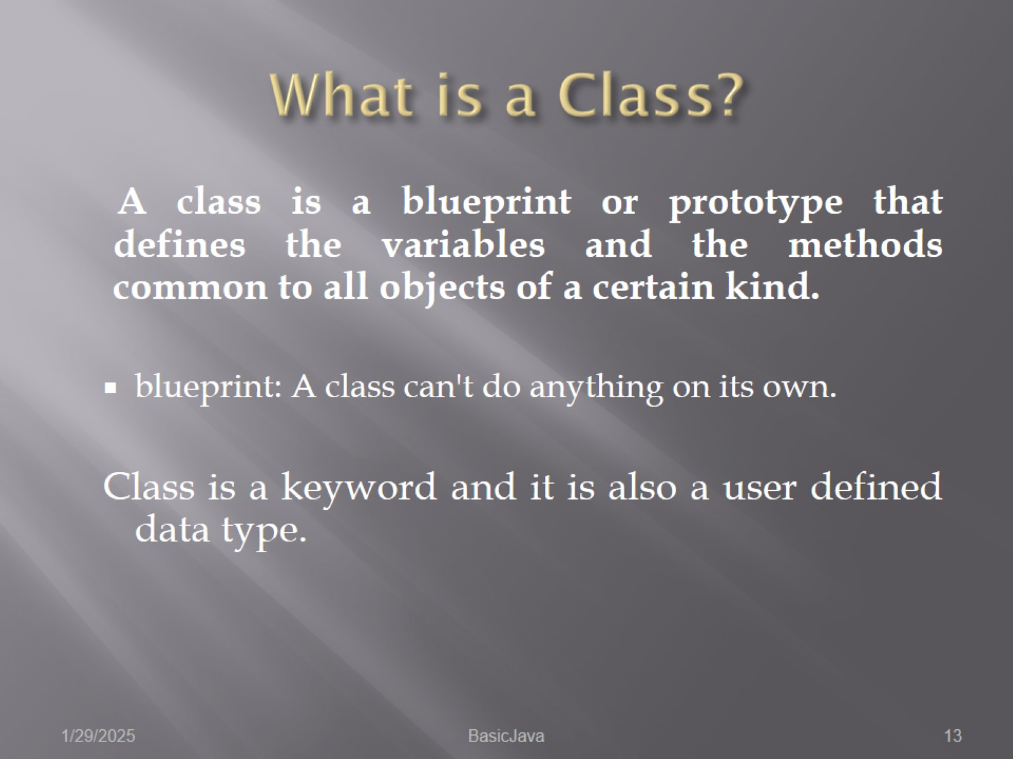
What is a Class?

Slide 14
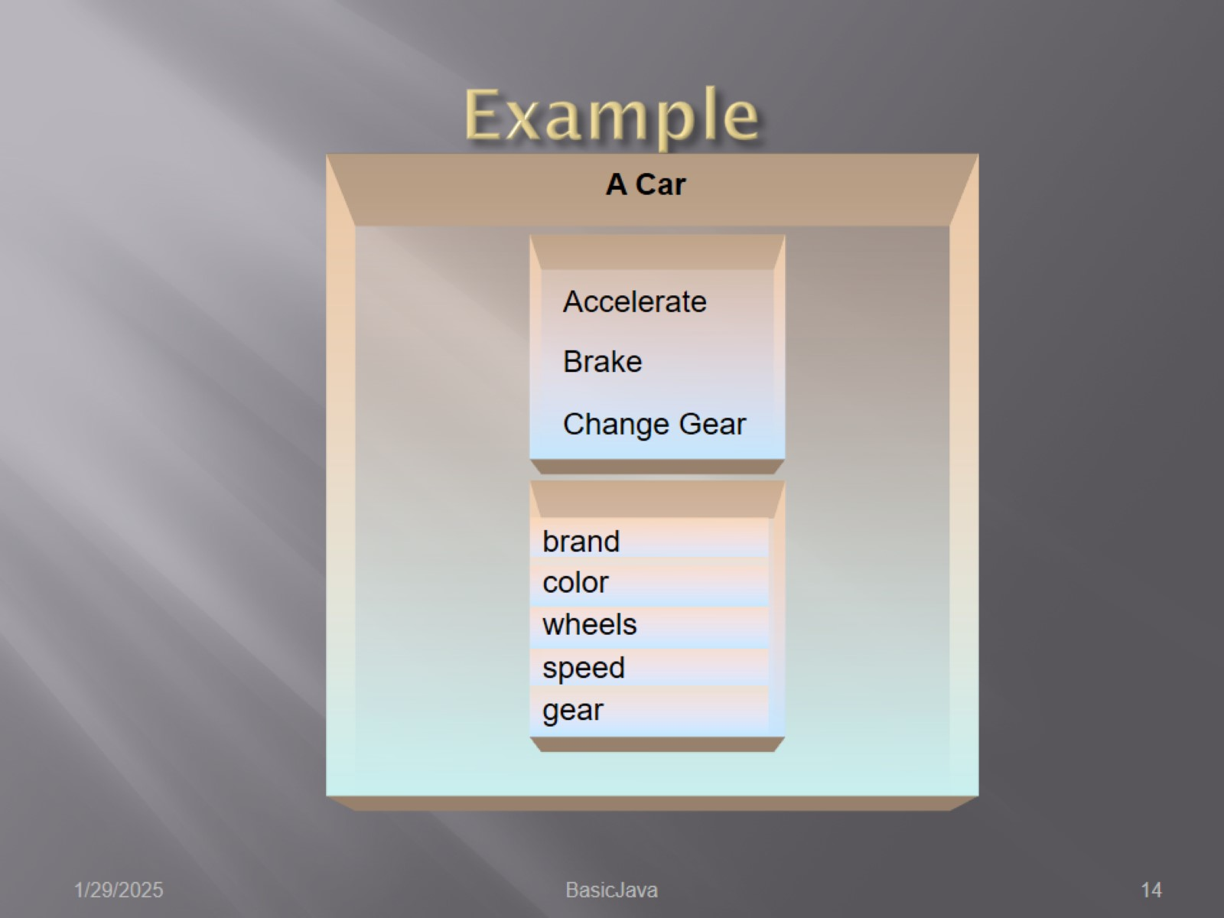
Example

Slide 15
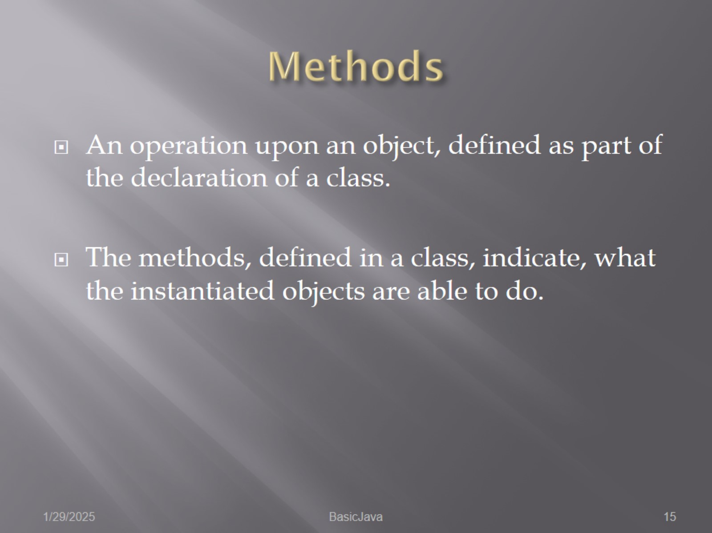
Methods

Slide 16
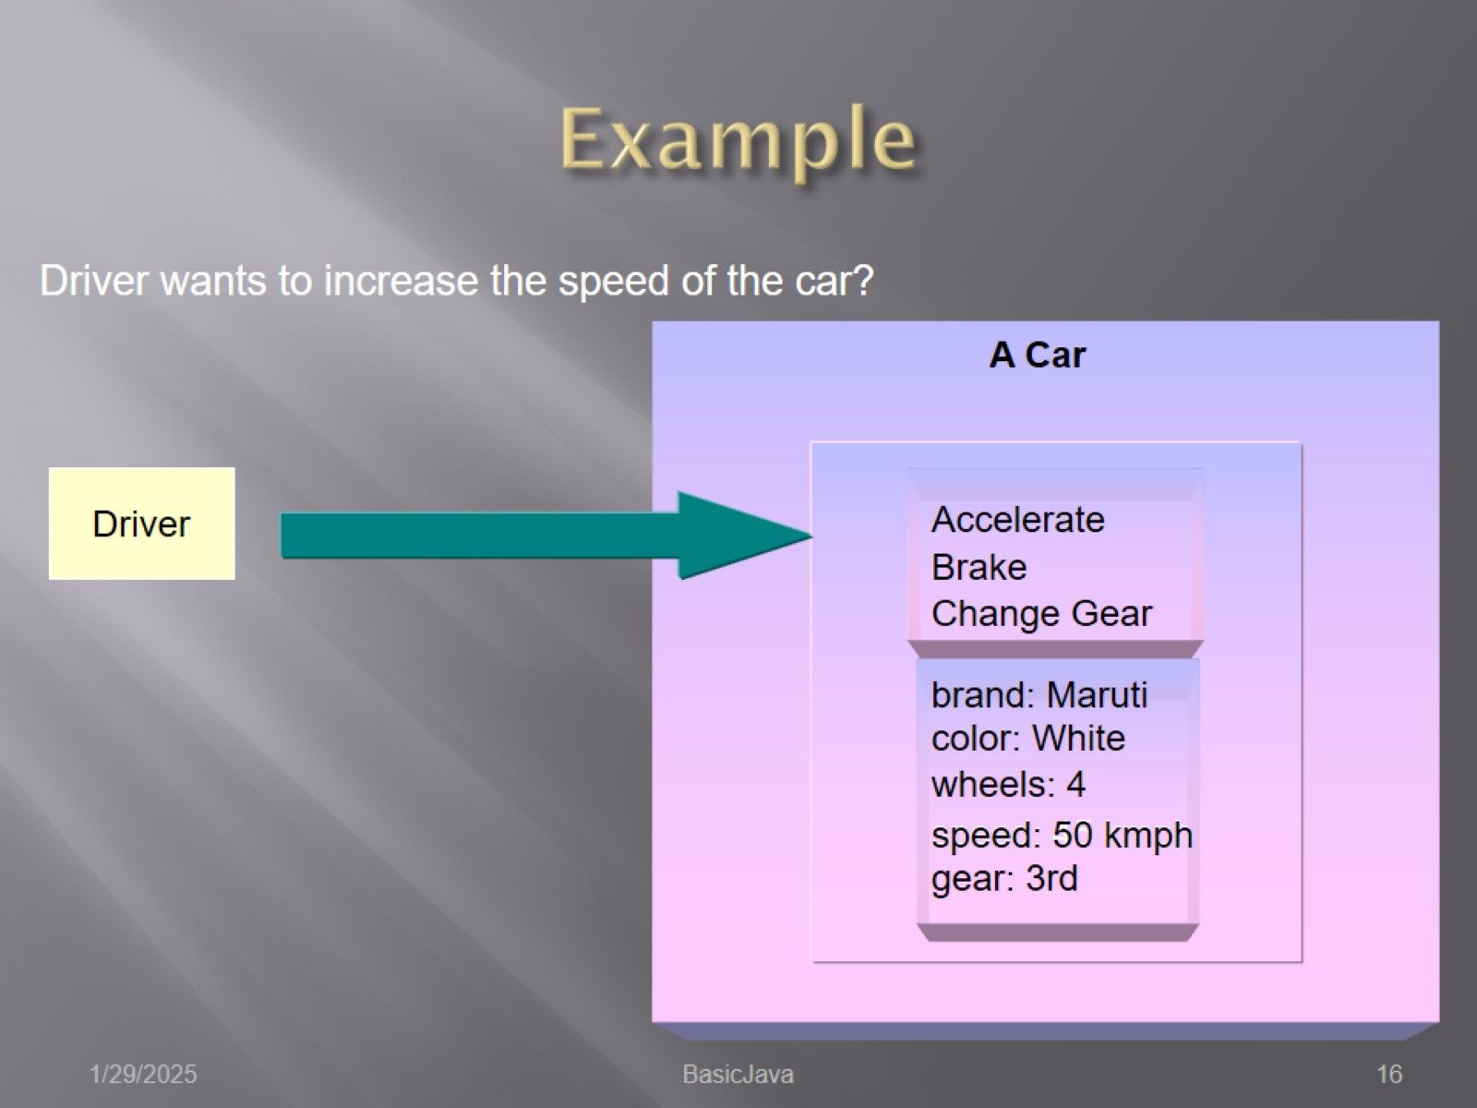
Example

Slide 17
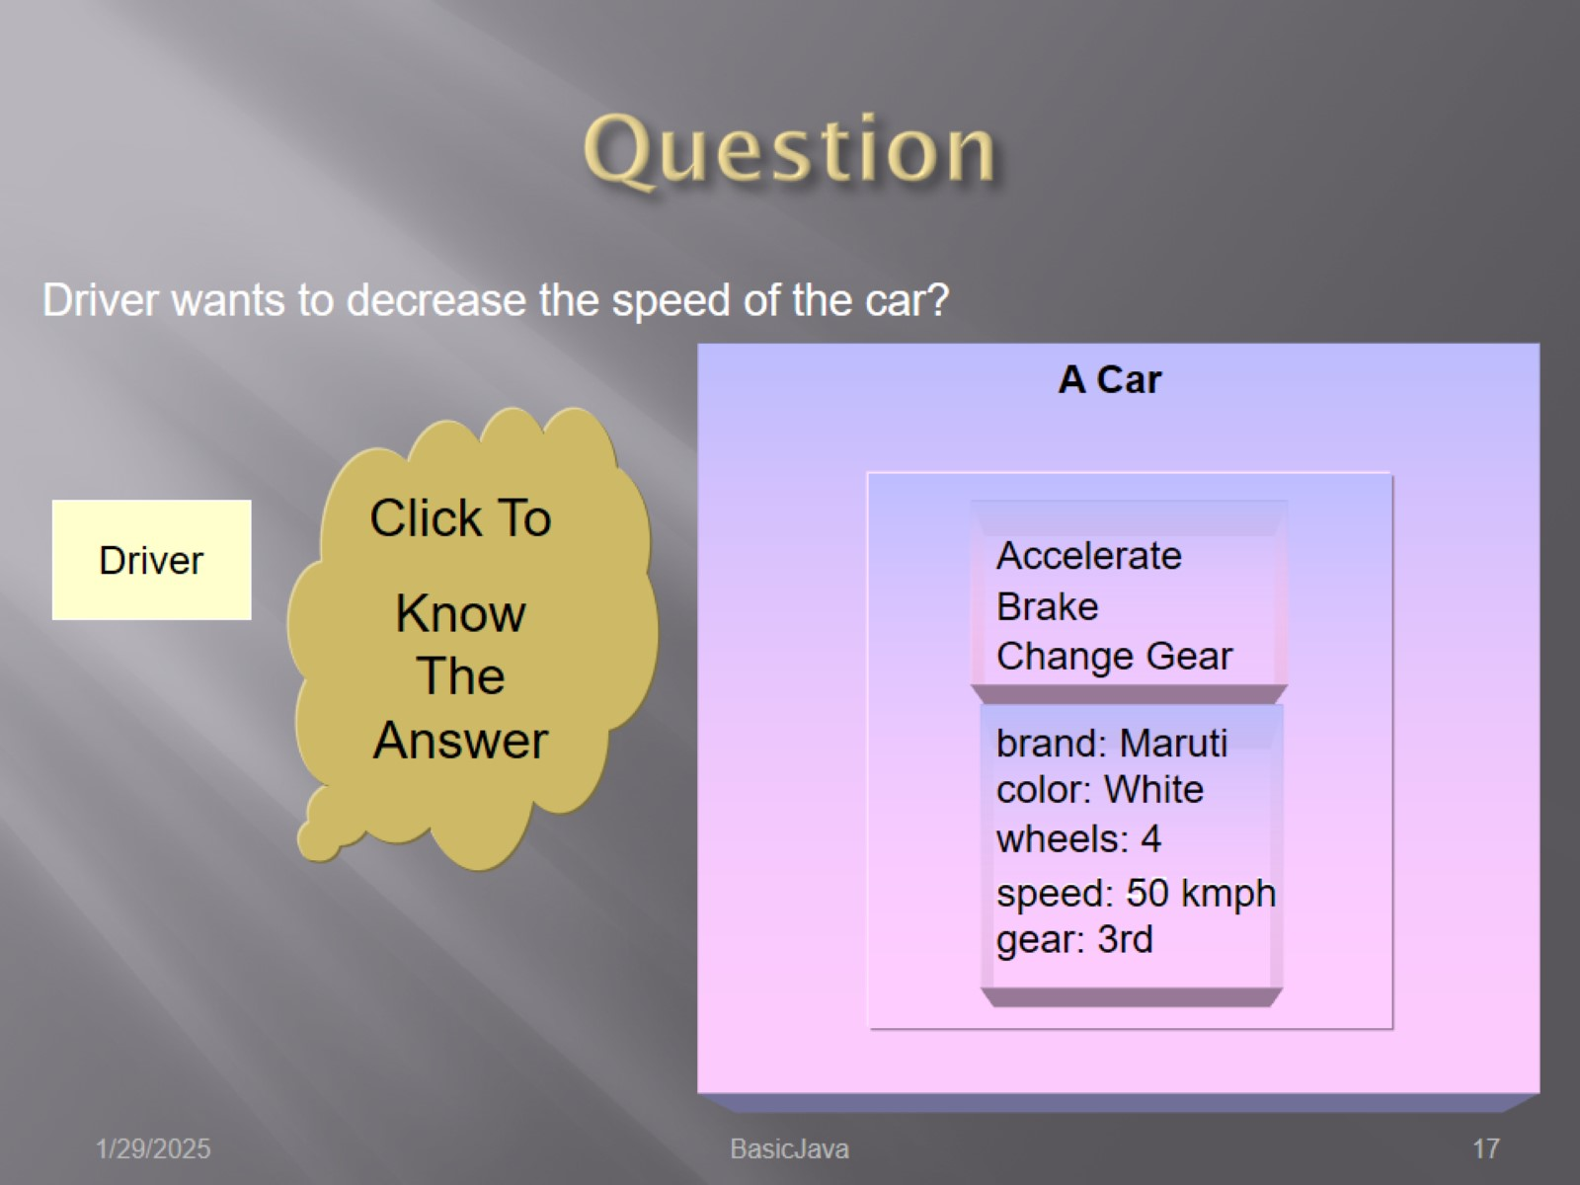
Question

Slide 18
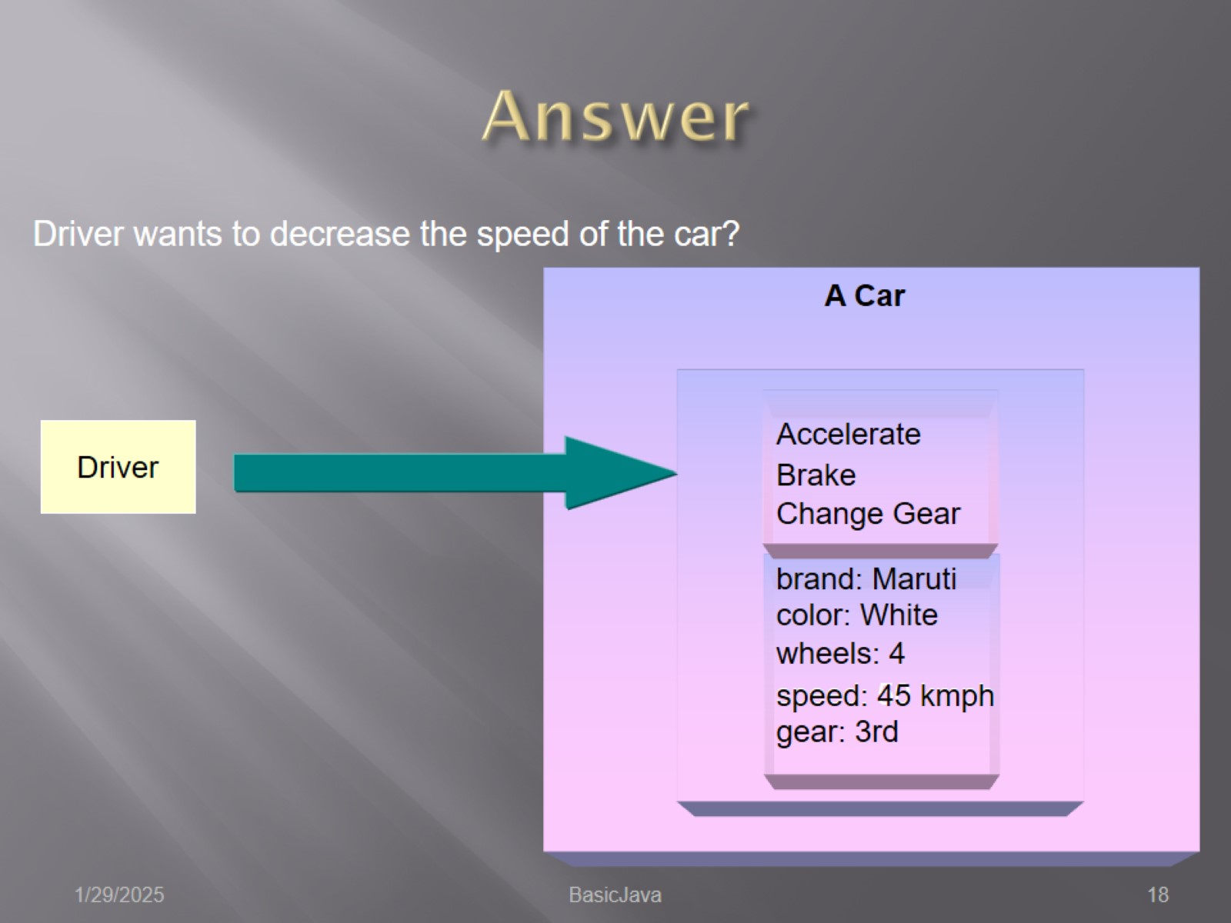
Answer

Slide 19
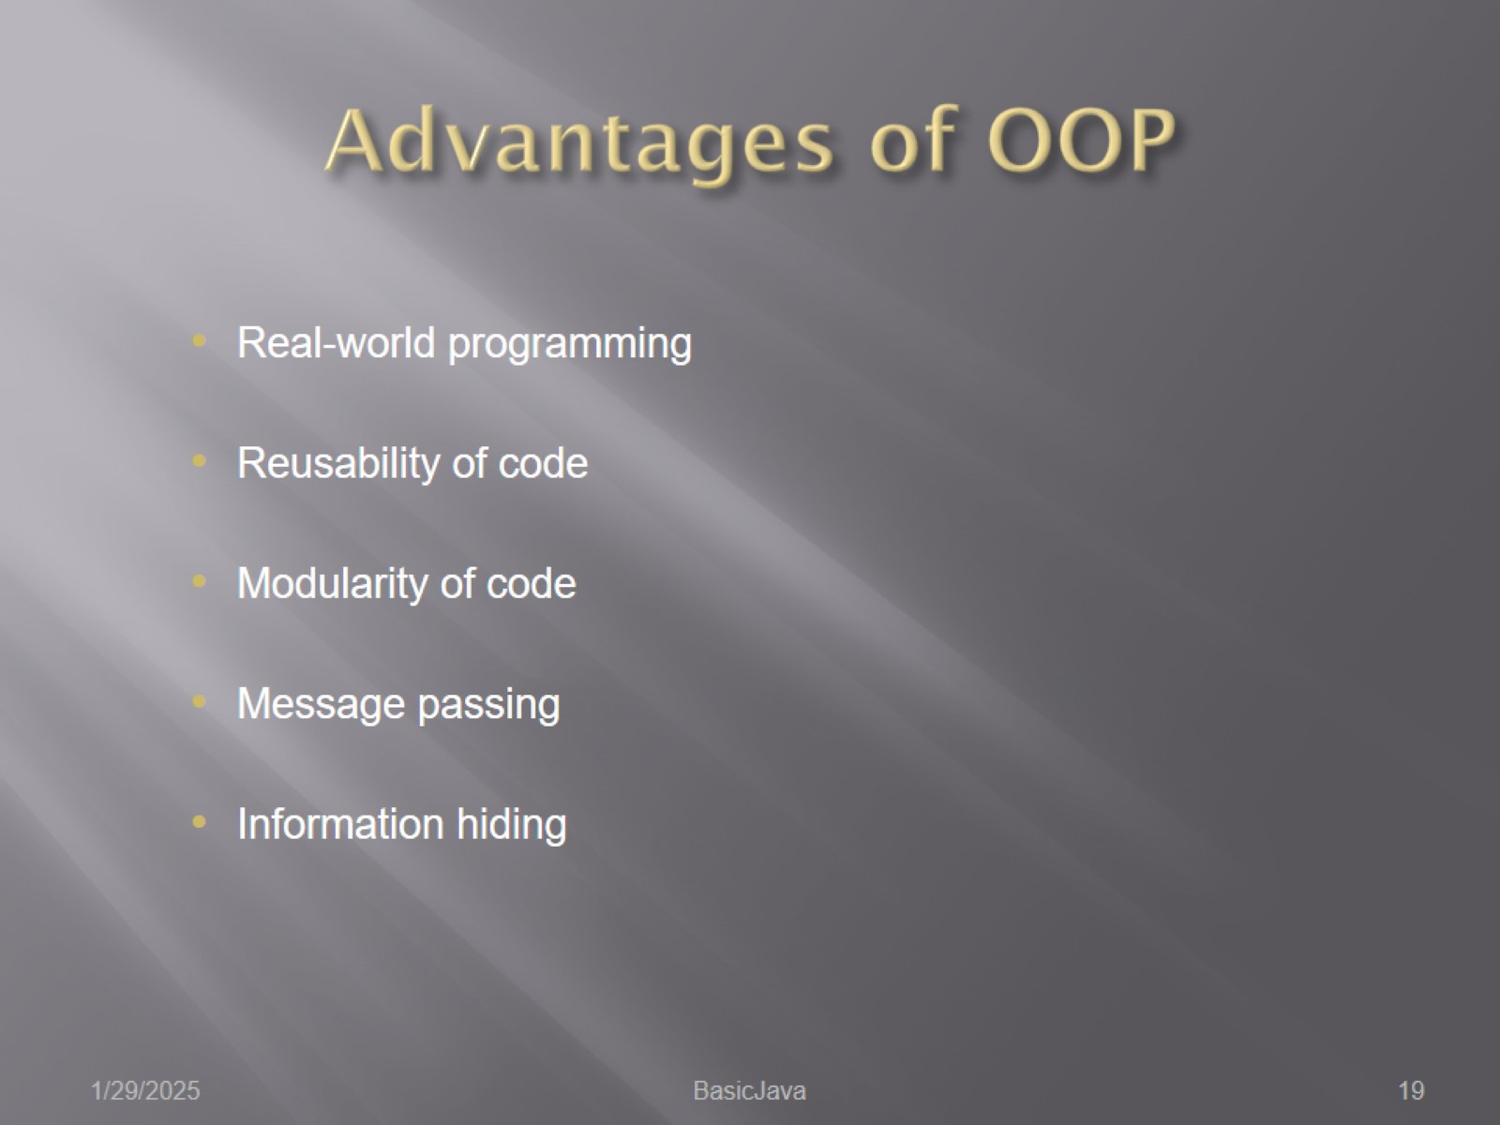
Advantages of OOP

Slide 20
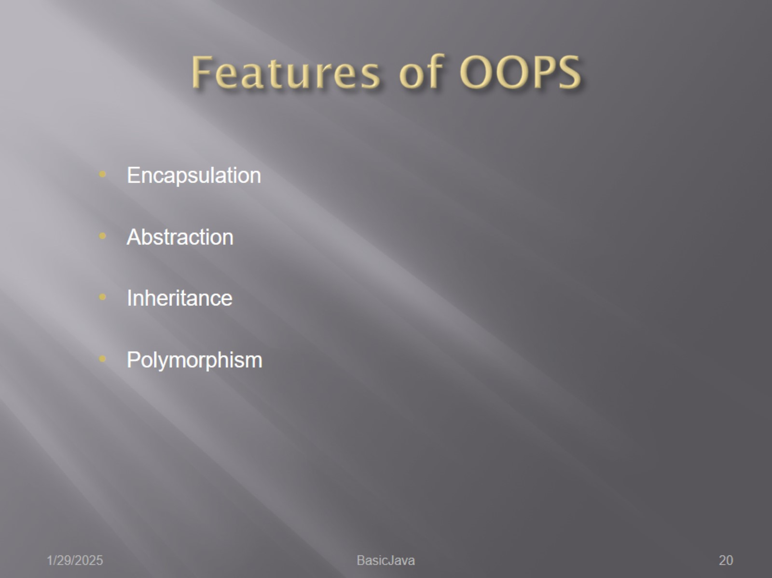
Features of OOPS

Slide 21
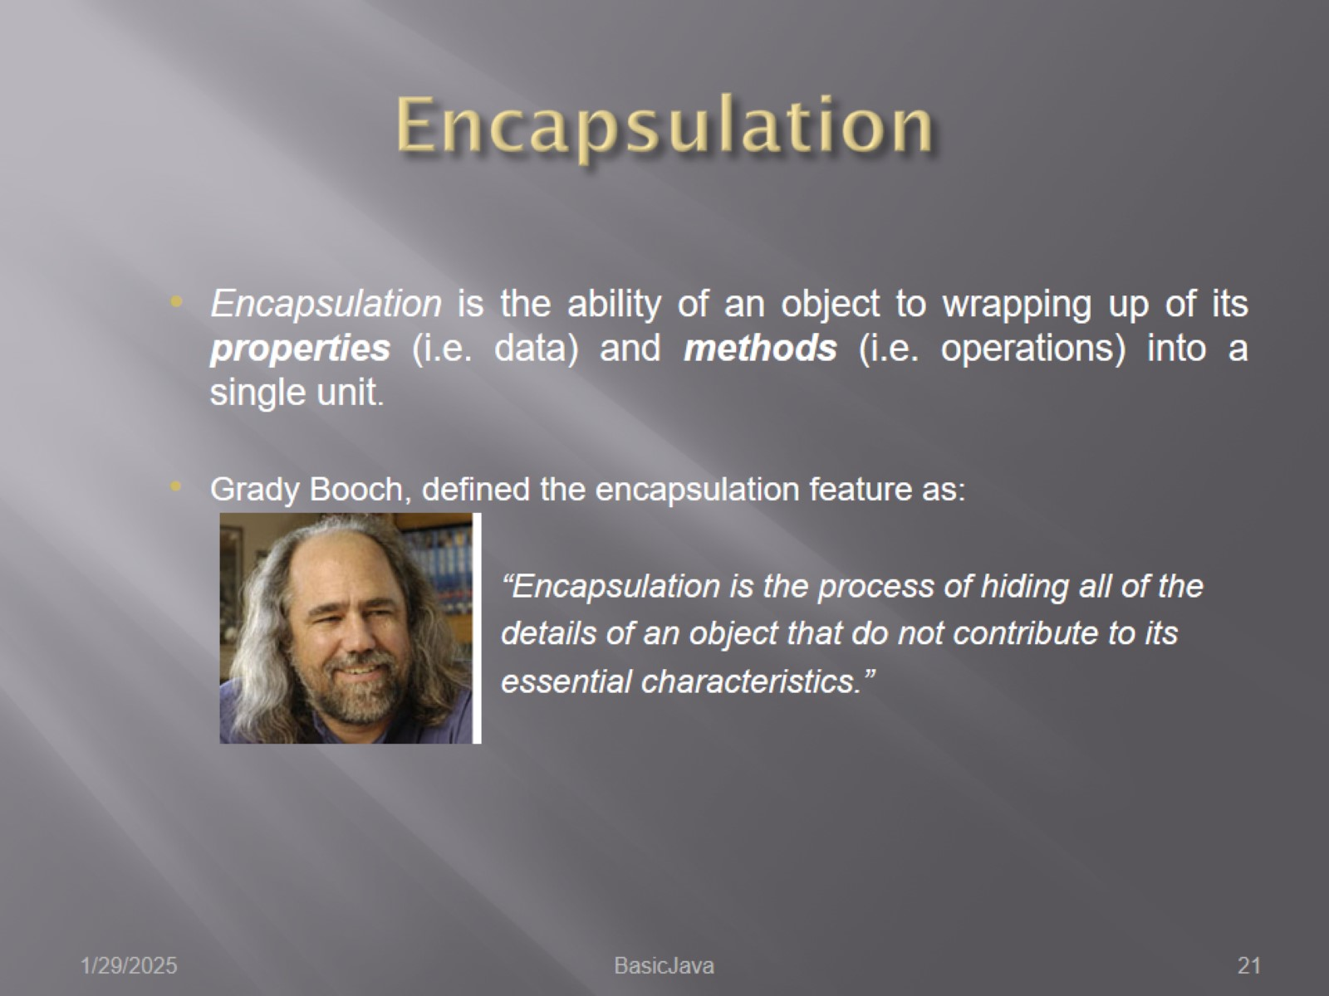
Encapsulation

Slide 22
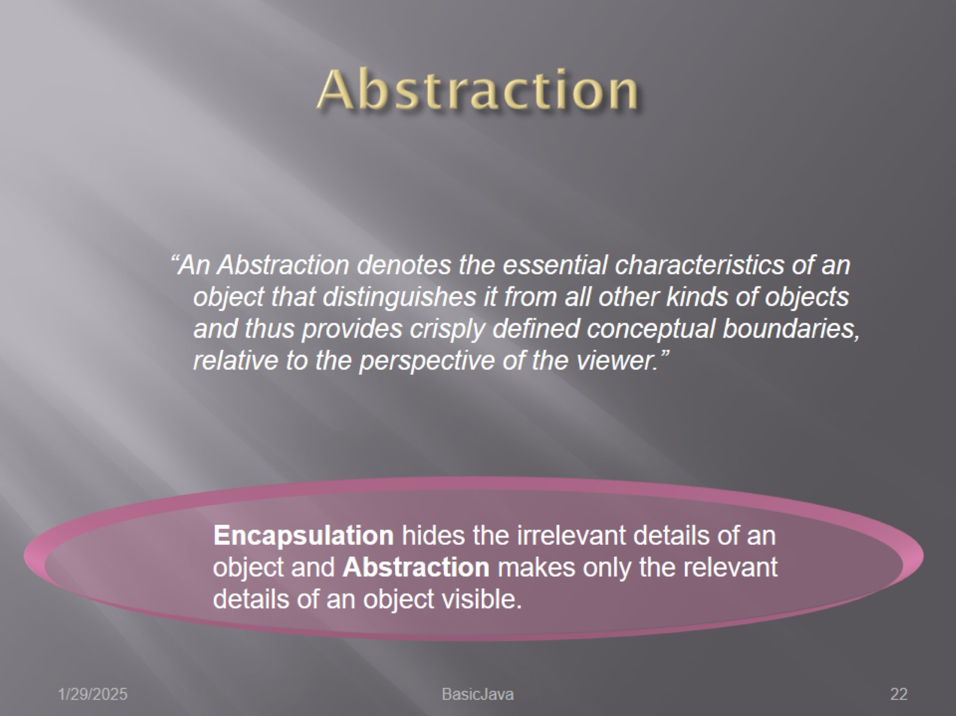
Abstraction

Slide 23
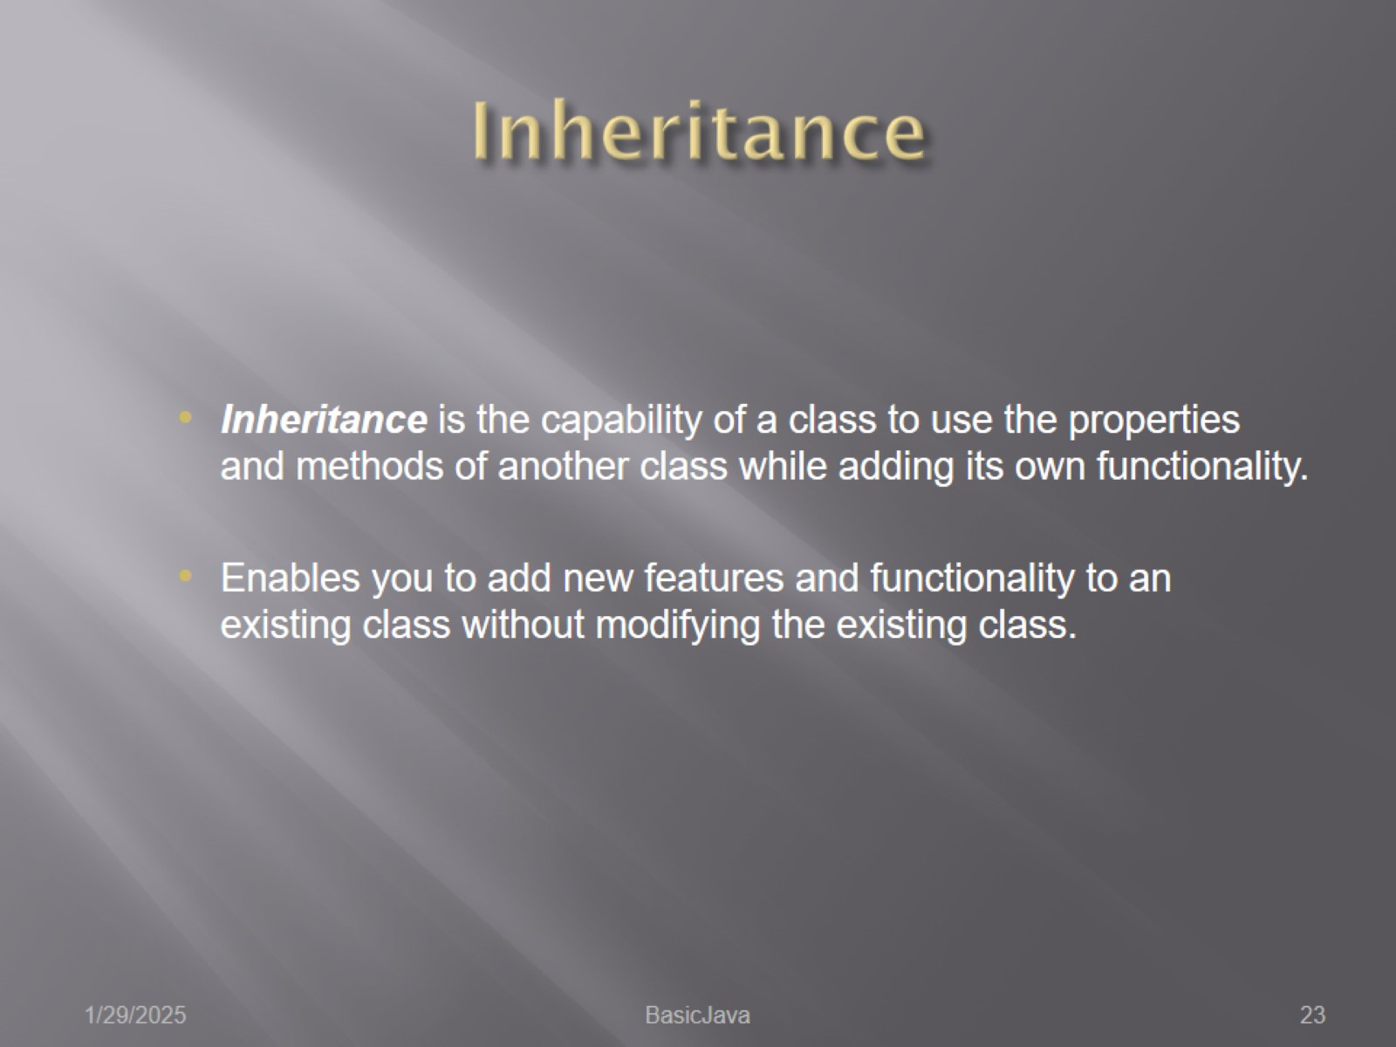
Inheritance

Slide 24
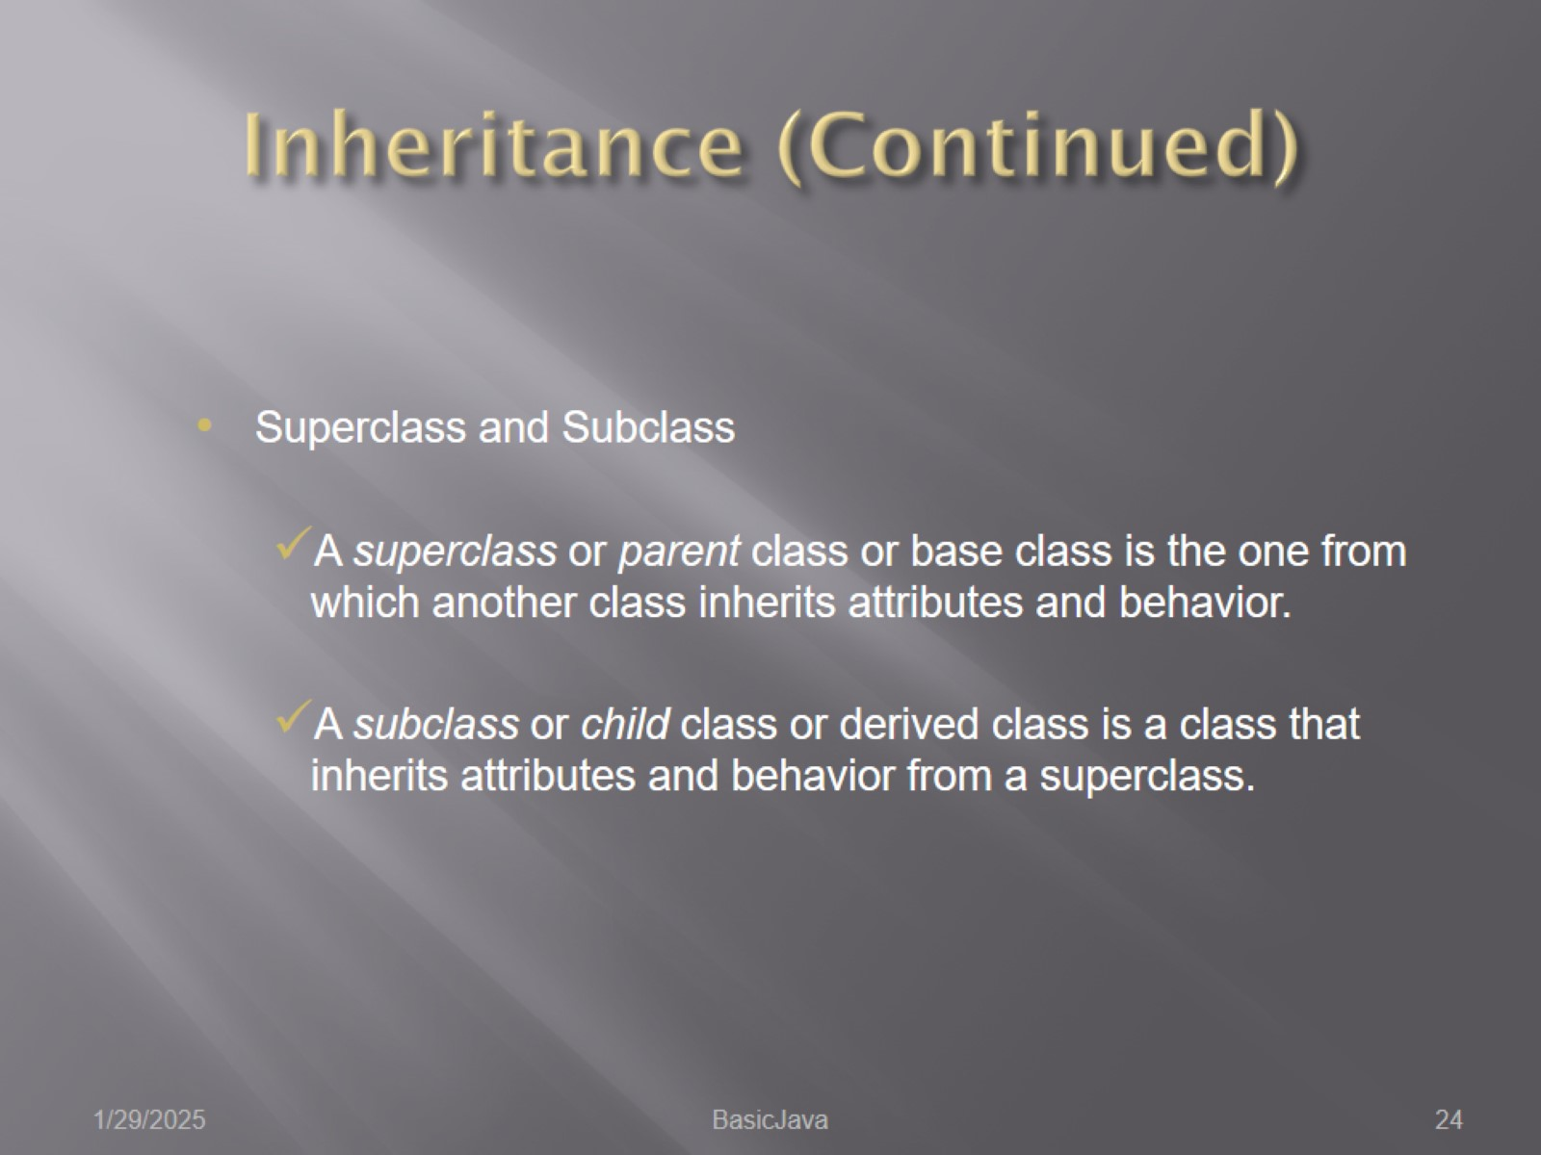
Inheritance (Continued)

Slide 25
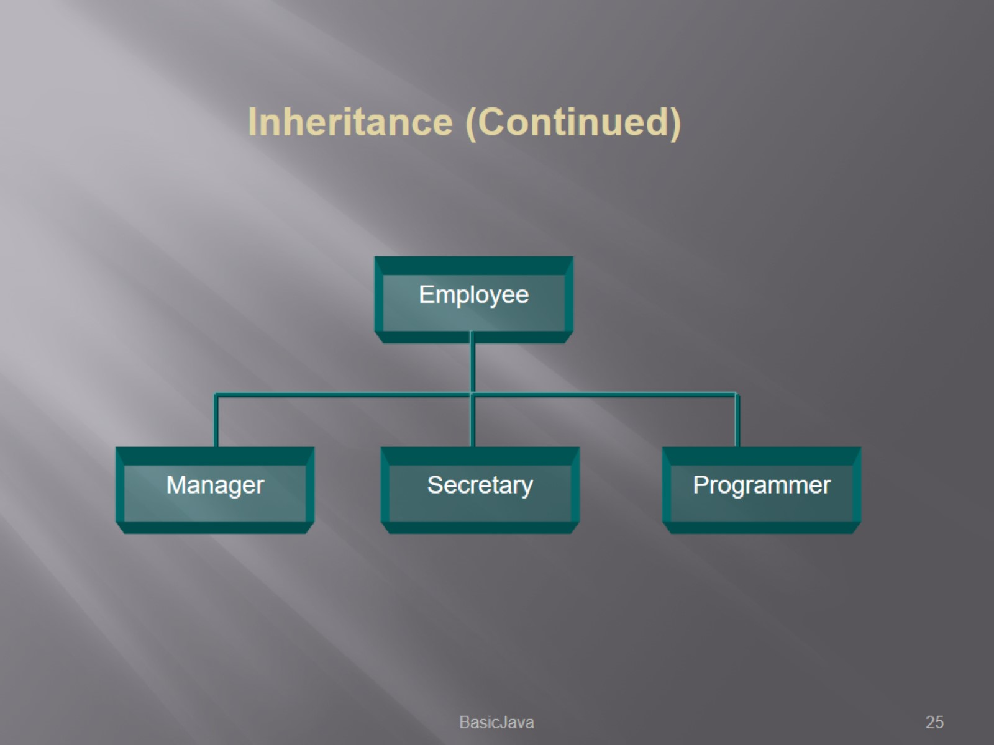

Slide 26
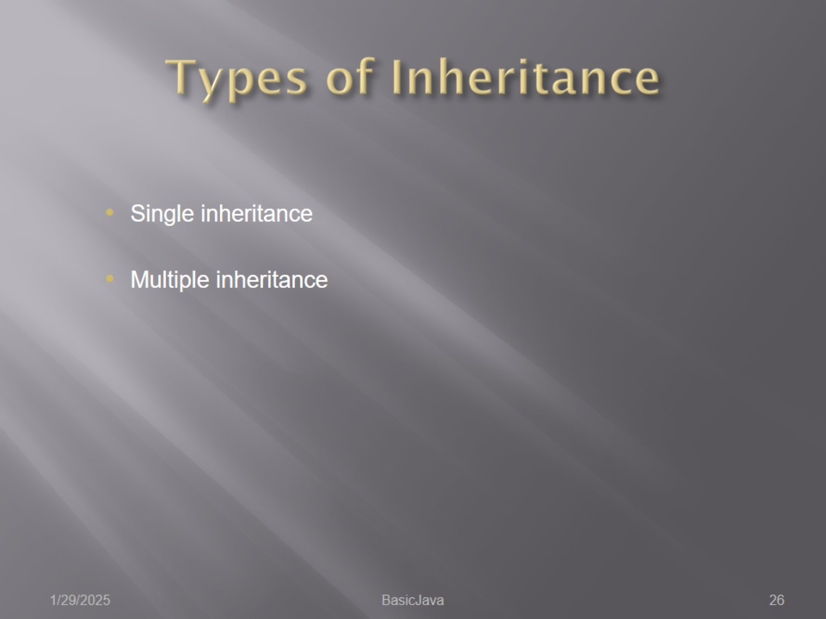
Types of Inheritance

Slide 27
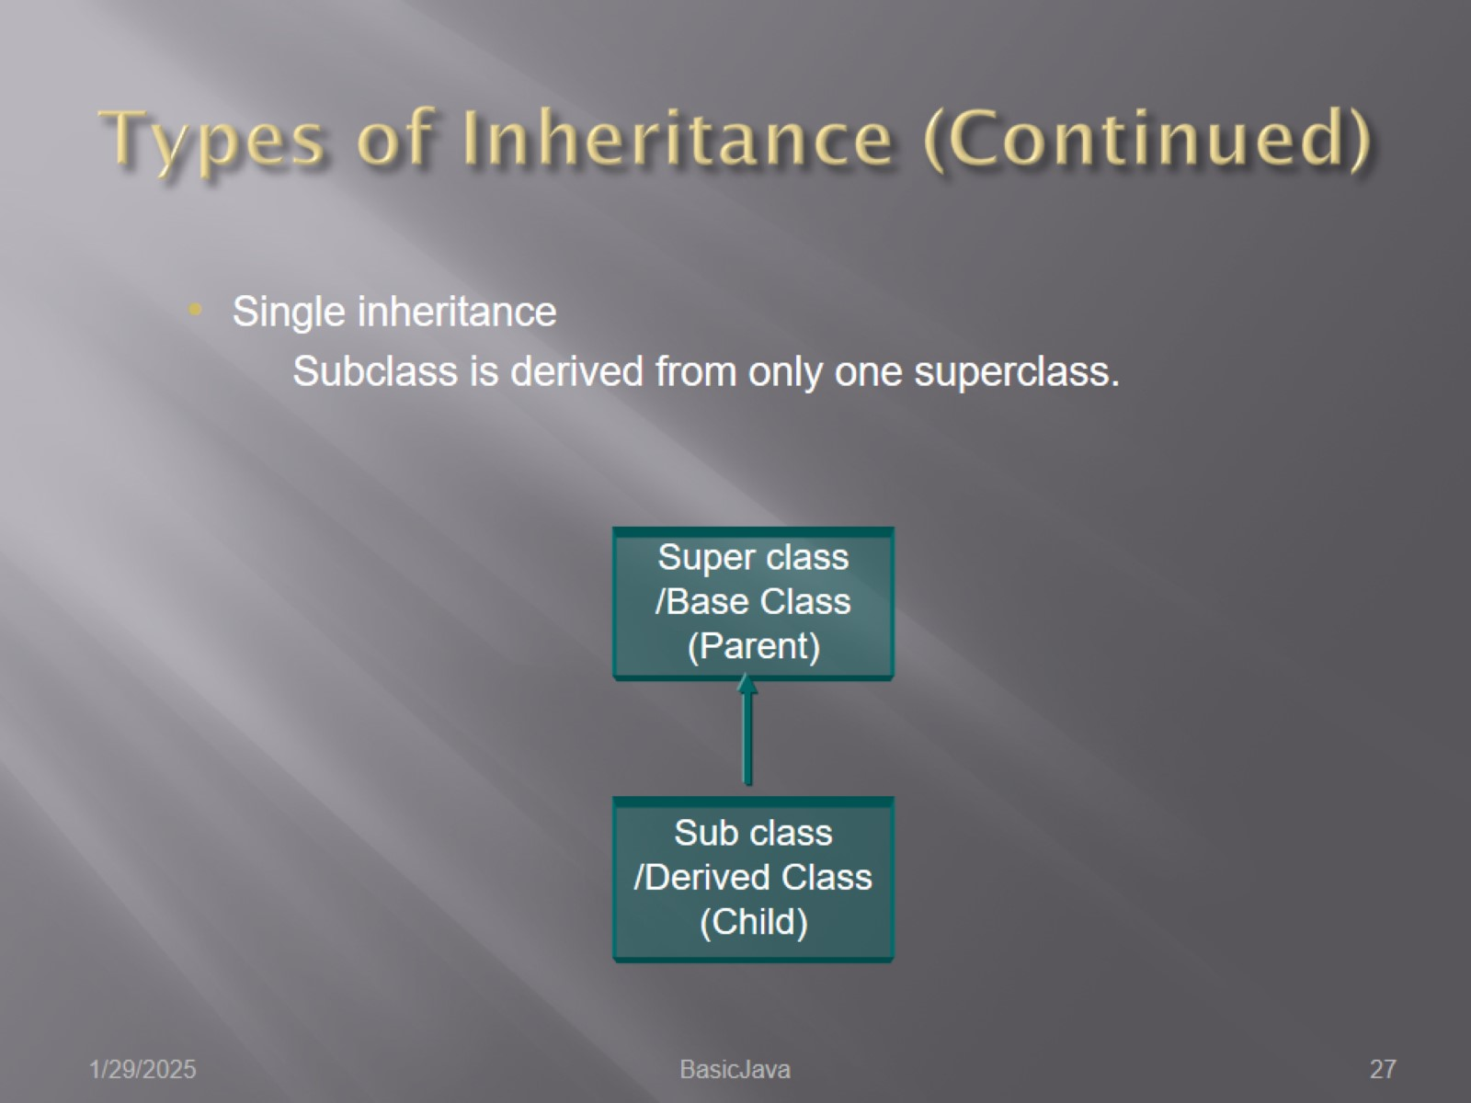
Types of Inheritance (Continued)

Slide 28
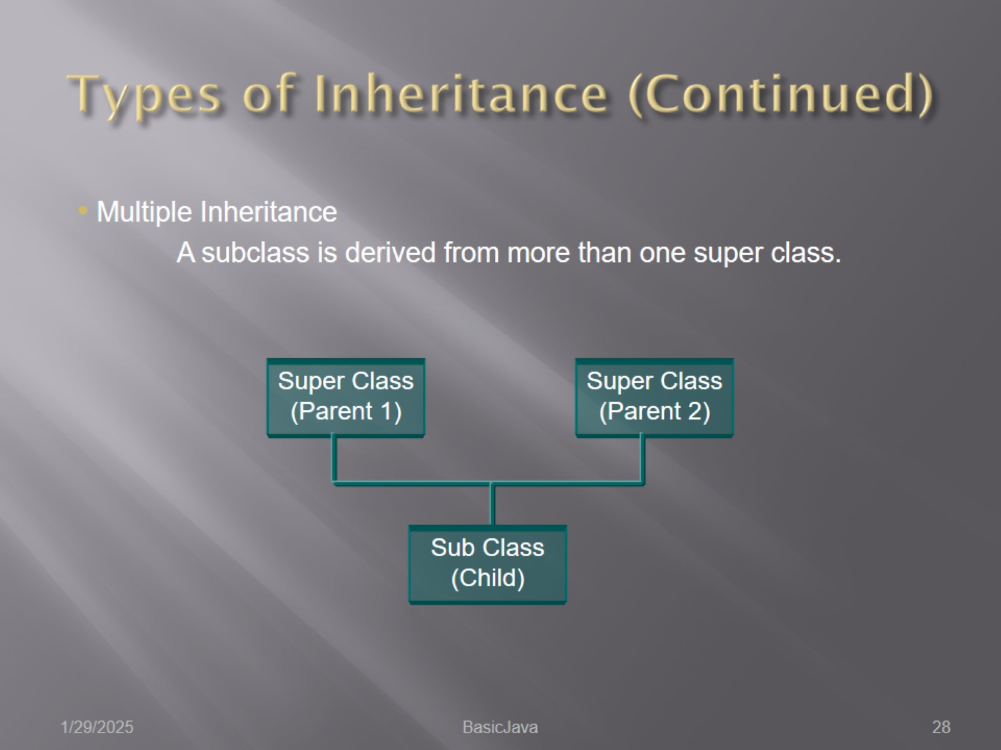
Types of Inheritance (Continued)

Slide 29
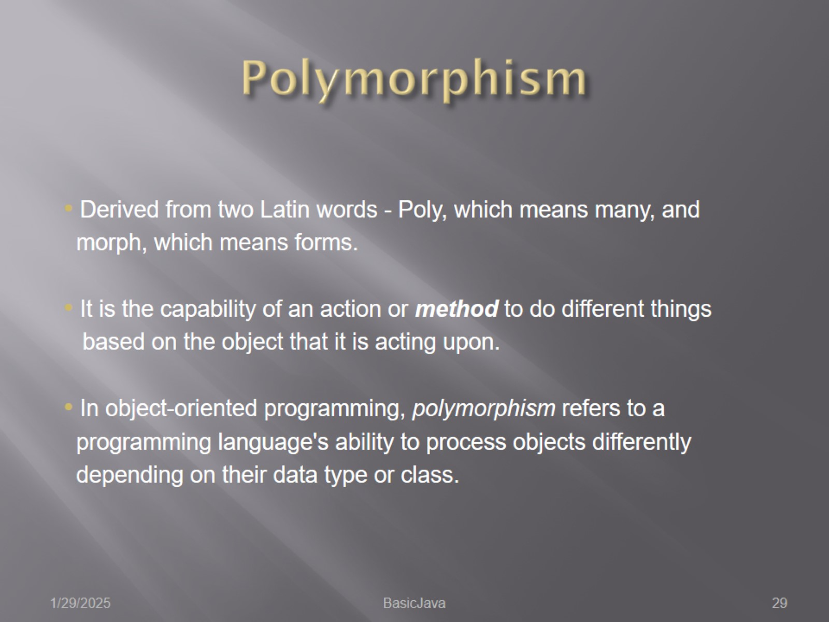
Polymorphism

Slide 30
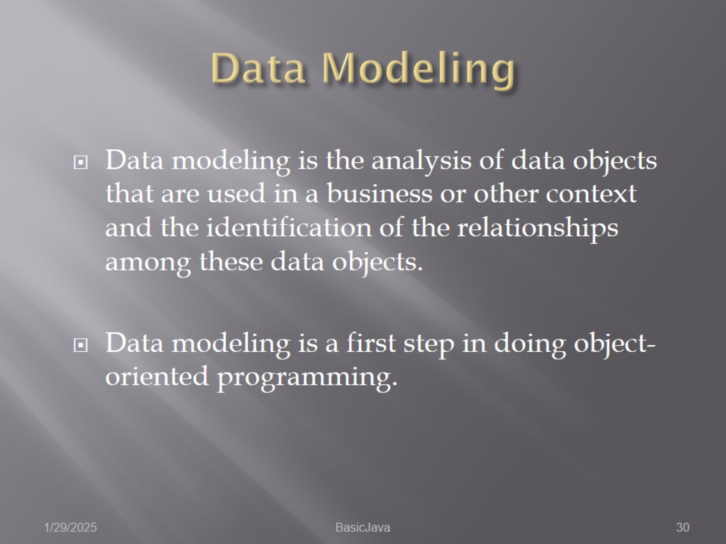
Data Modeling

Slide 31
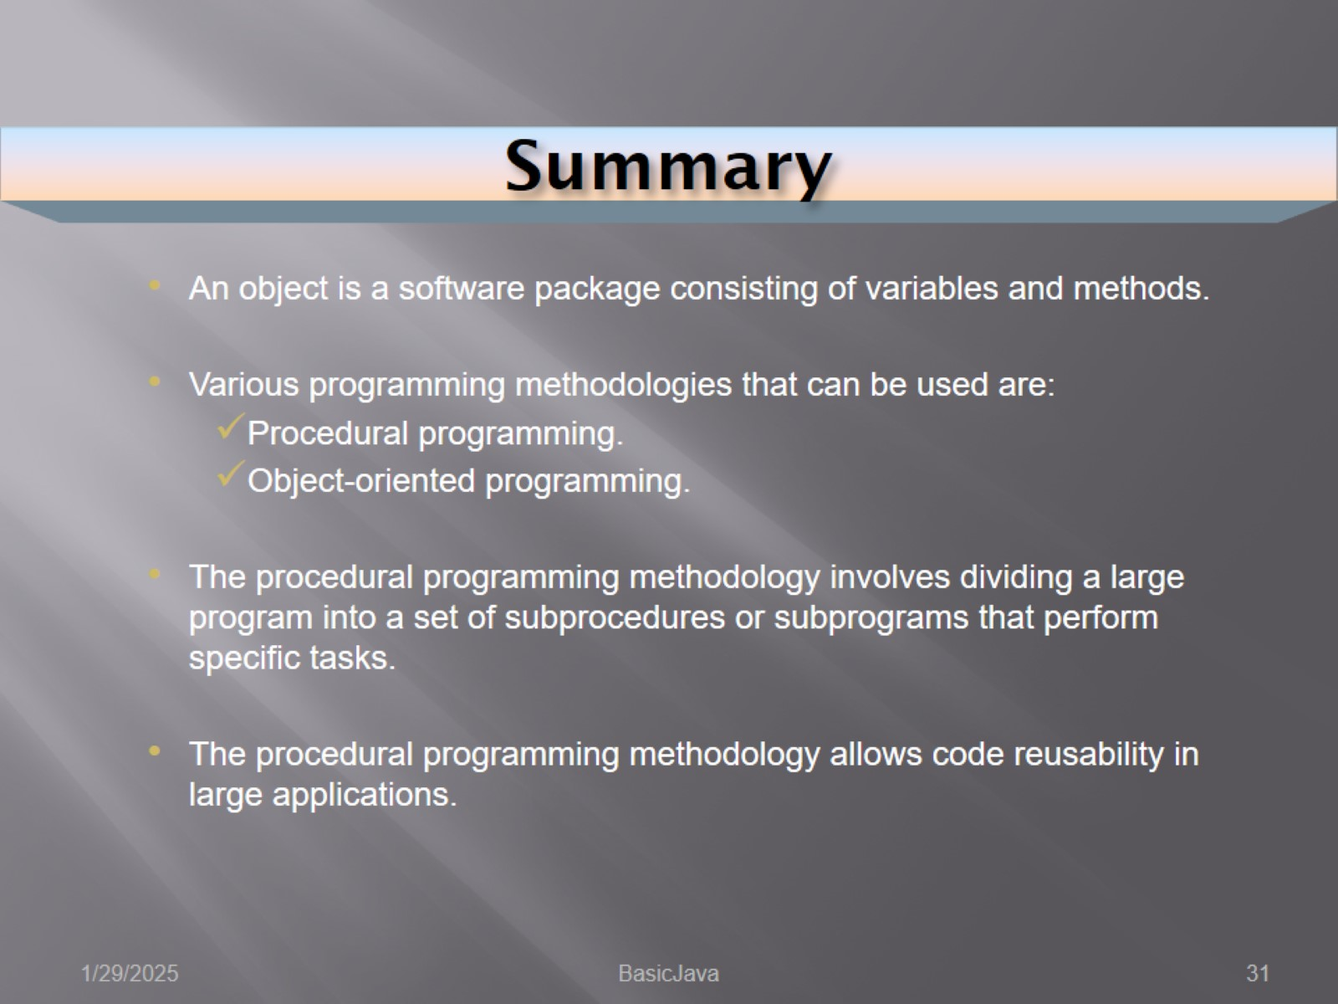
Summary

Slide 32
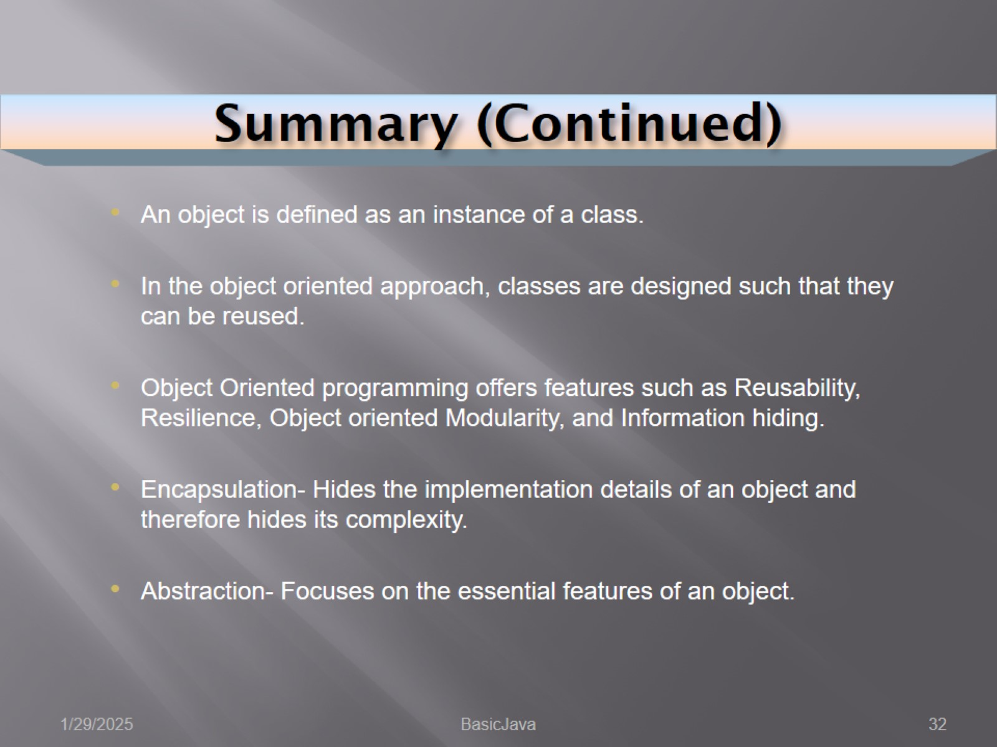
Summary (Continued)

Slide 33
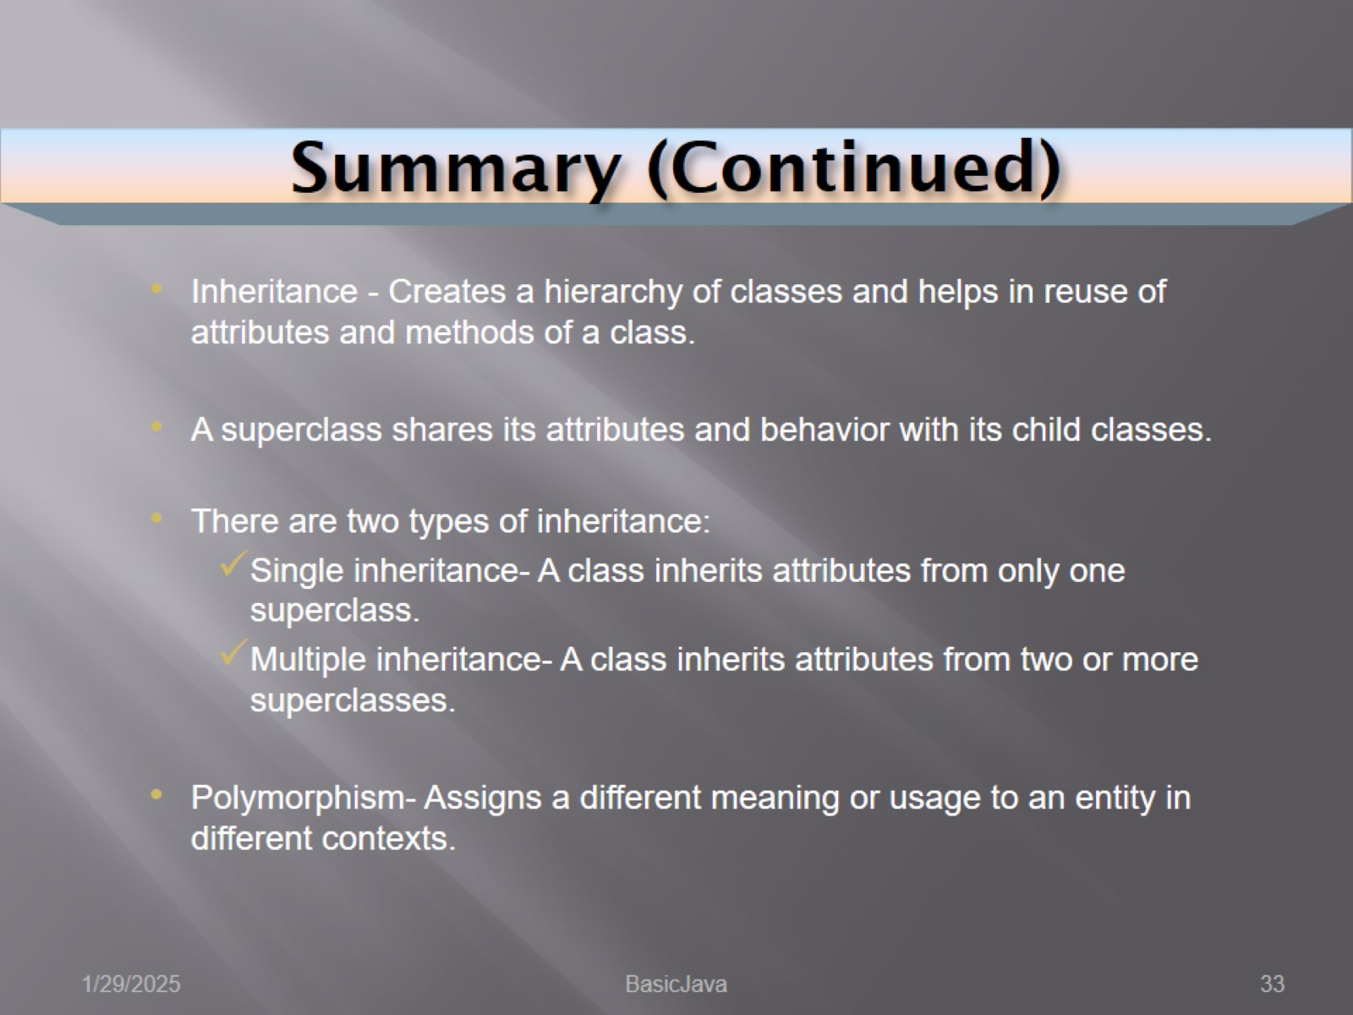
Summary (Continued)

Slide 34
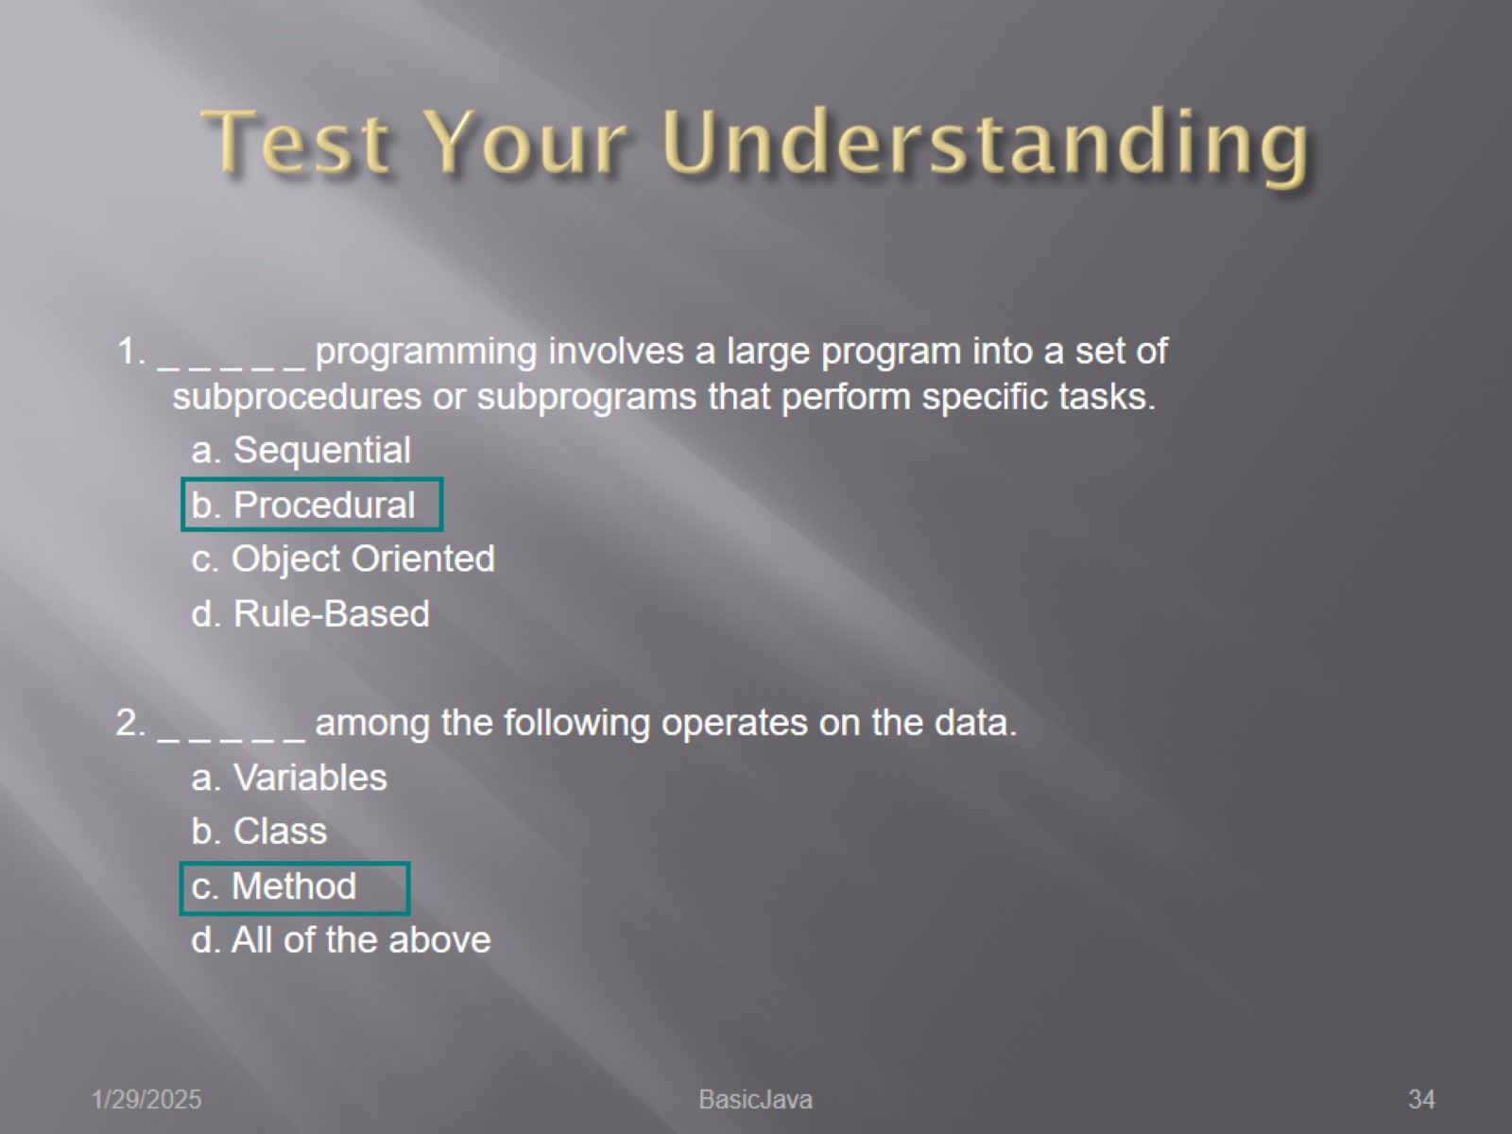
Test Your Understanding

Slide 35
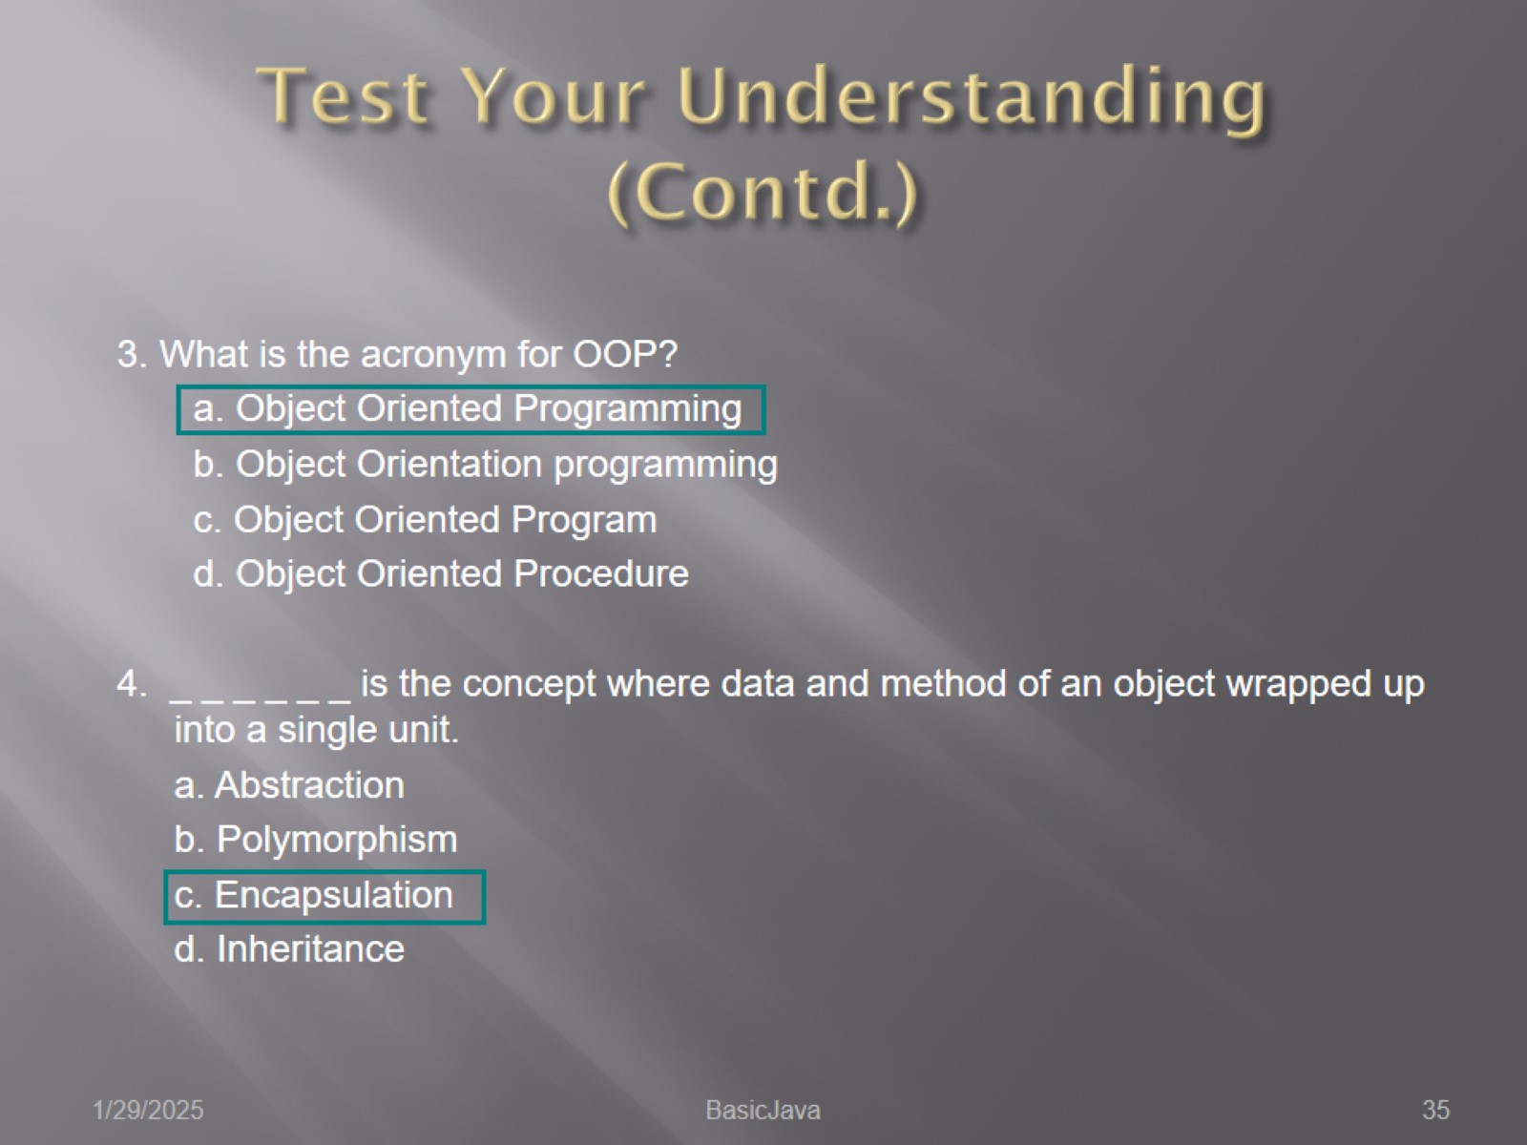
Test Your Understanding (Contd.)

Slide 36
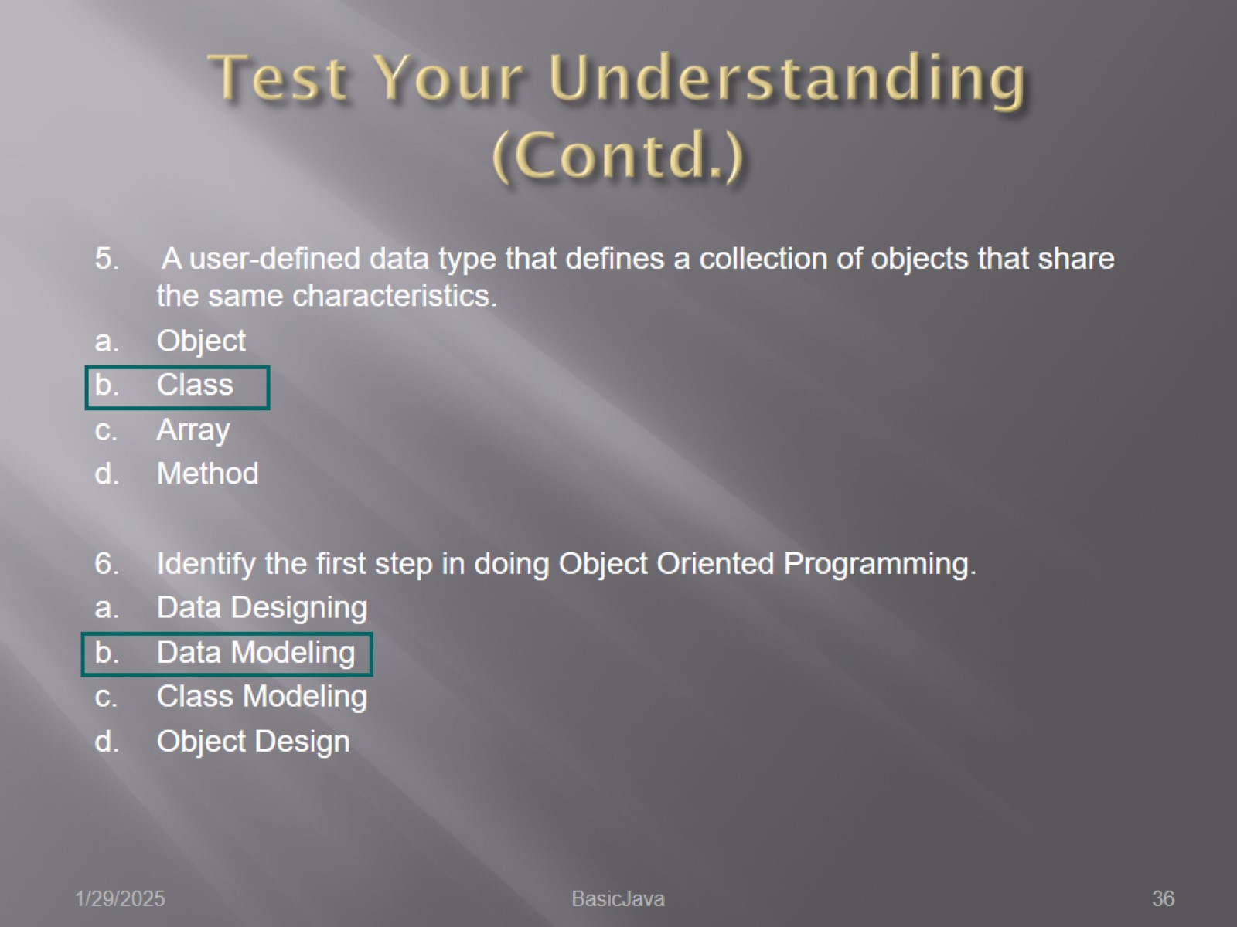
Test Your Understanding (Contd.)

Slide 37
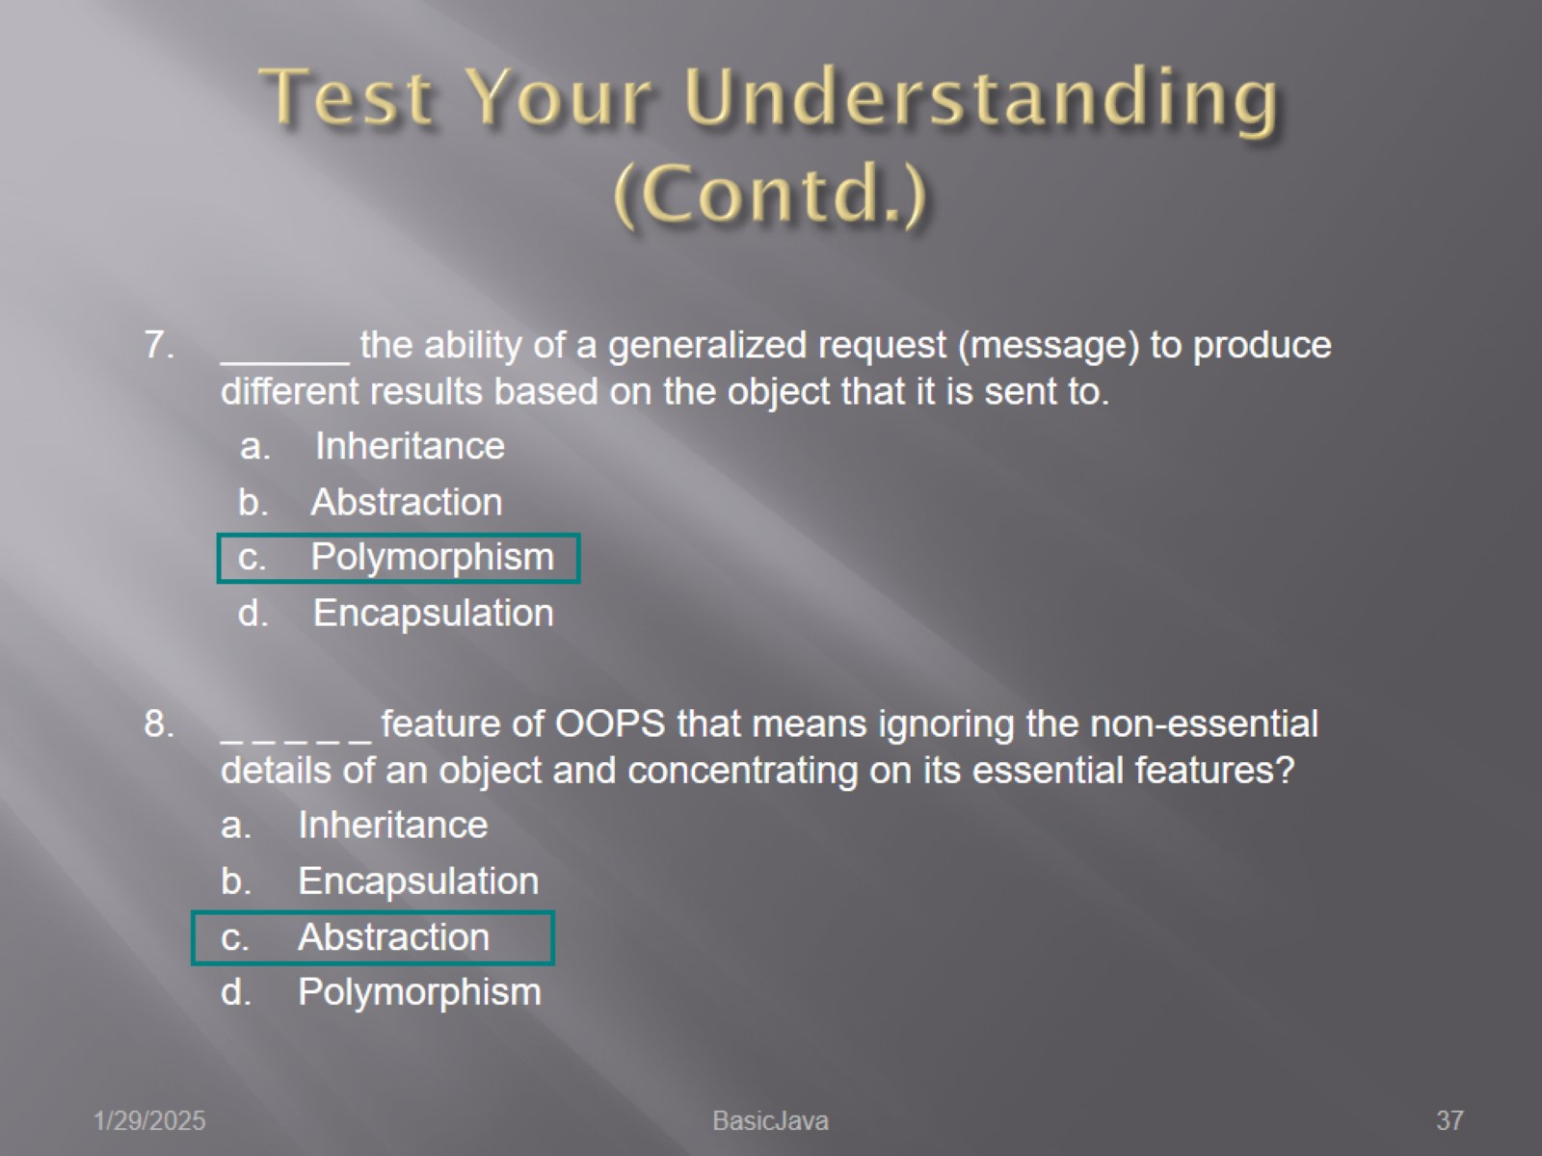
Test Your Understanding (Contd.)

Slide 38
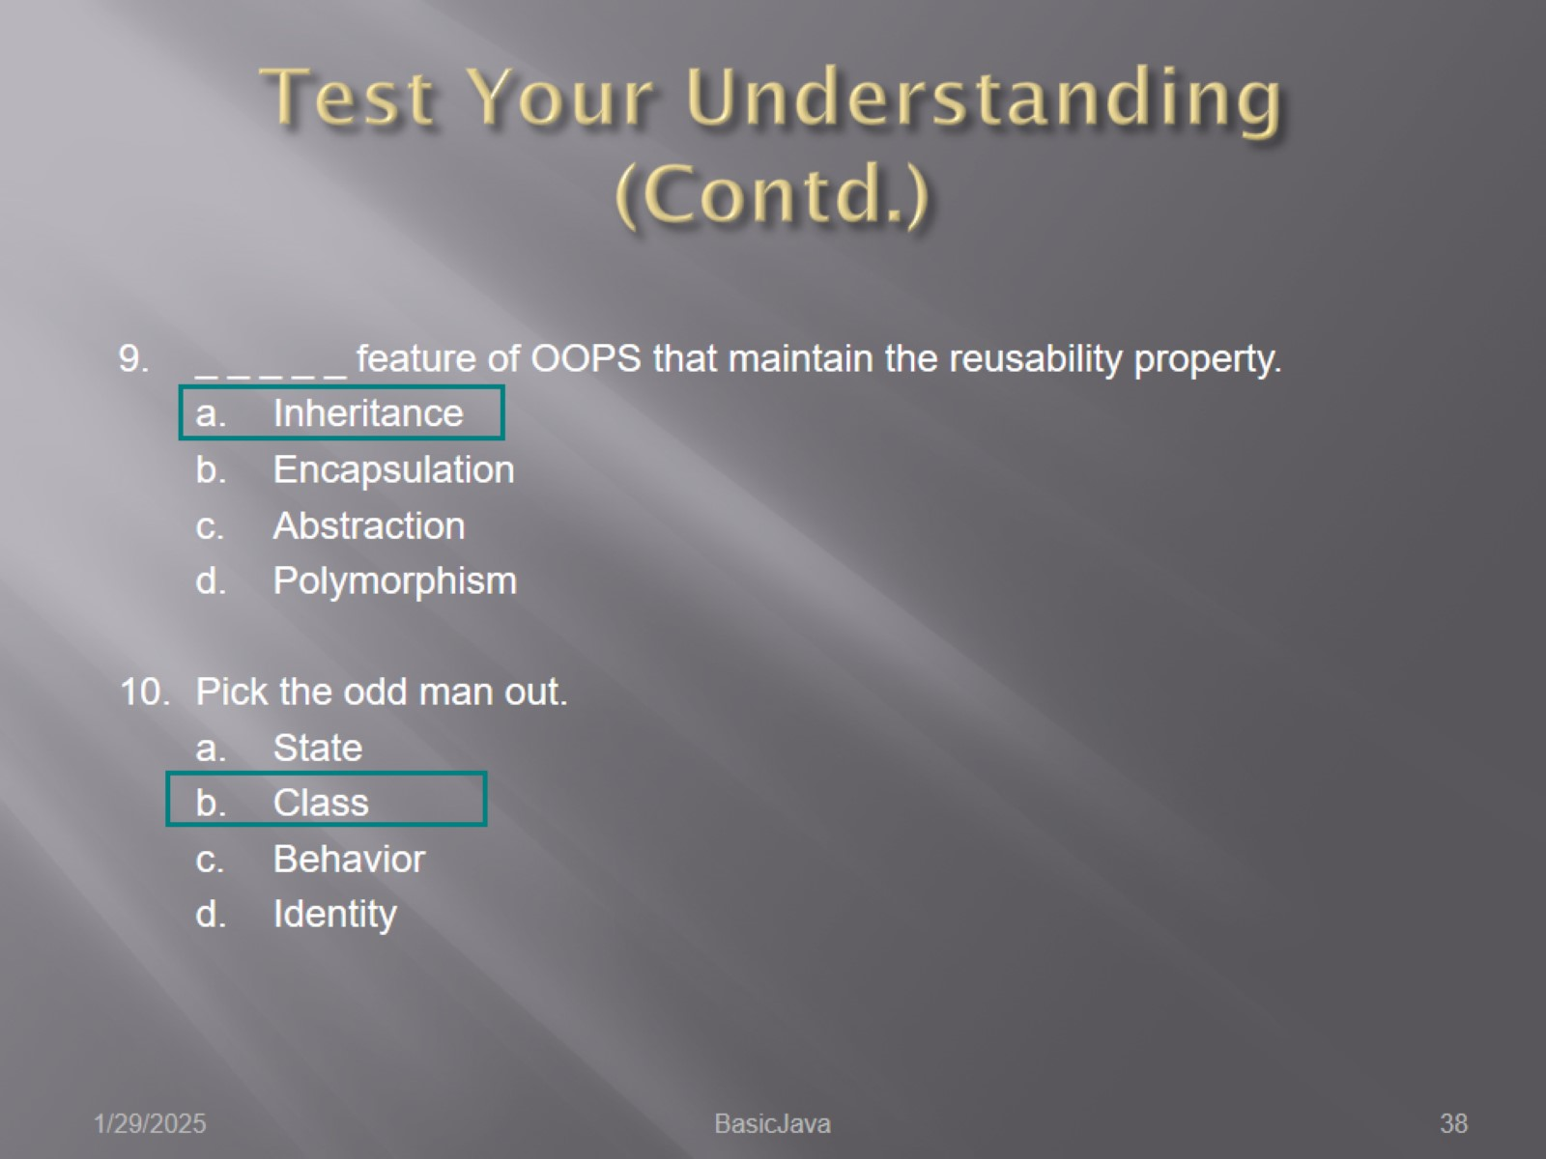
Test Your Understanding (Contd.)

Slide 39
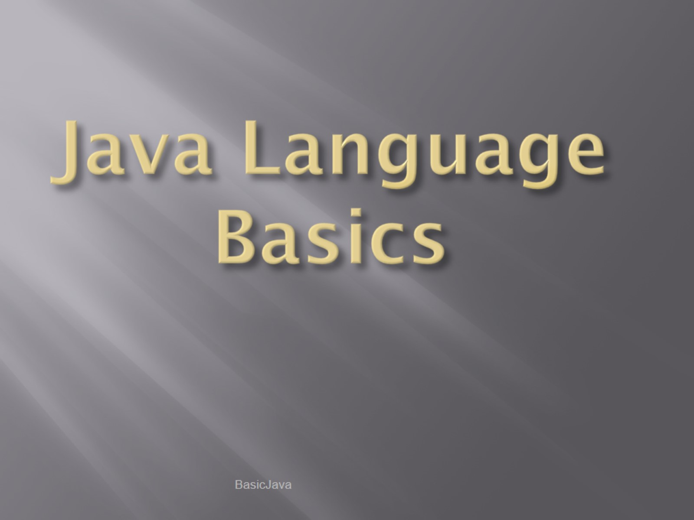
Java Language Basics

Slide 40
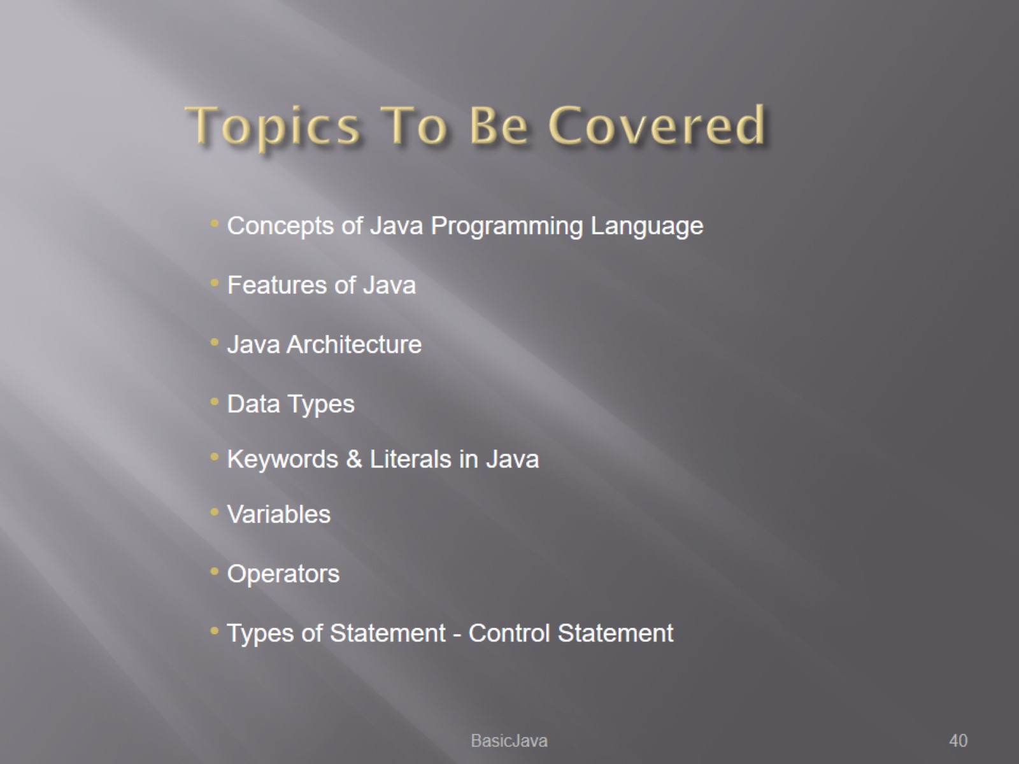
Topics To Be Covered

Slide 41
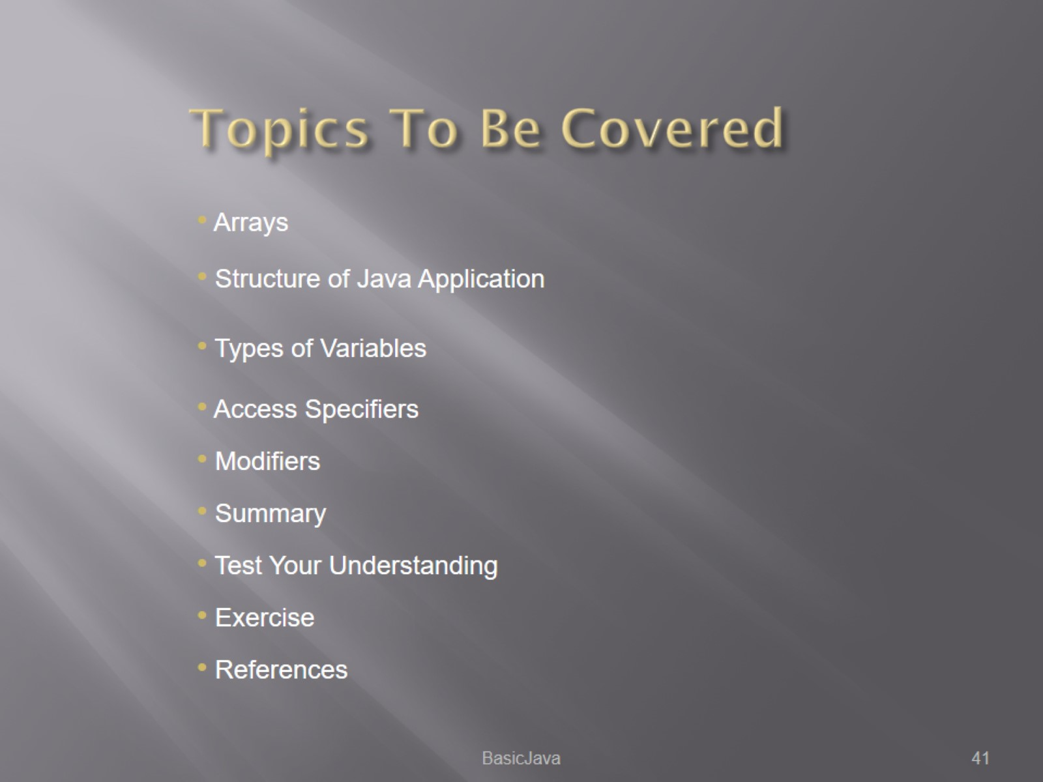
Topics To Be Covered

Slide 42
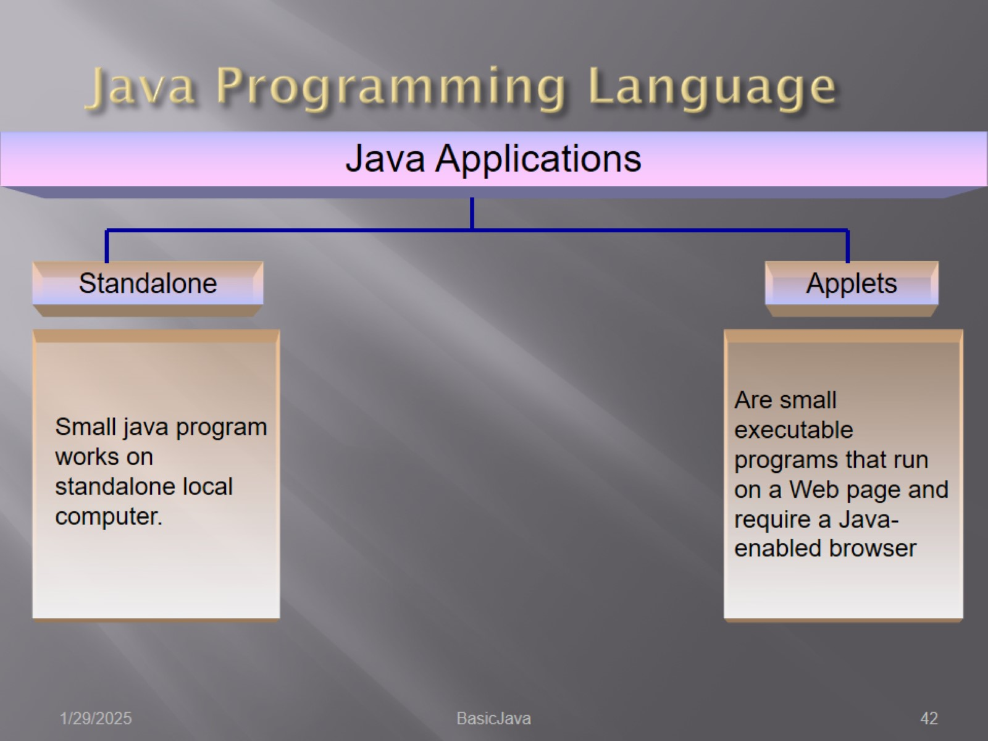
Java Programming Language

Slide 43
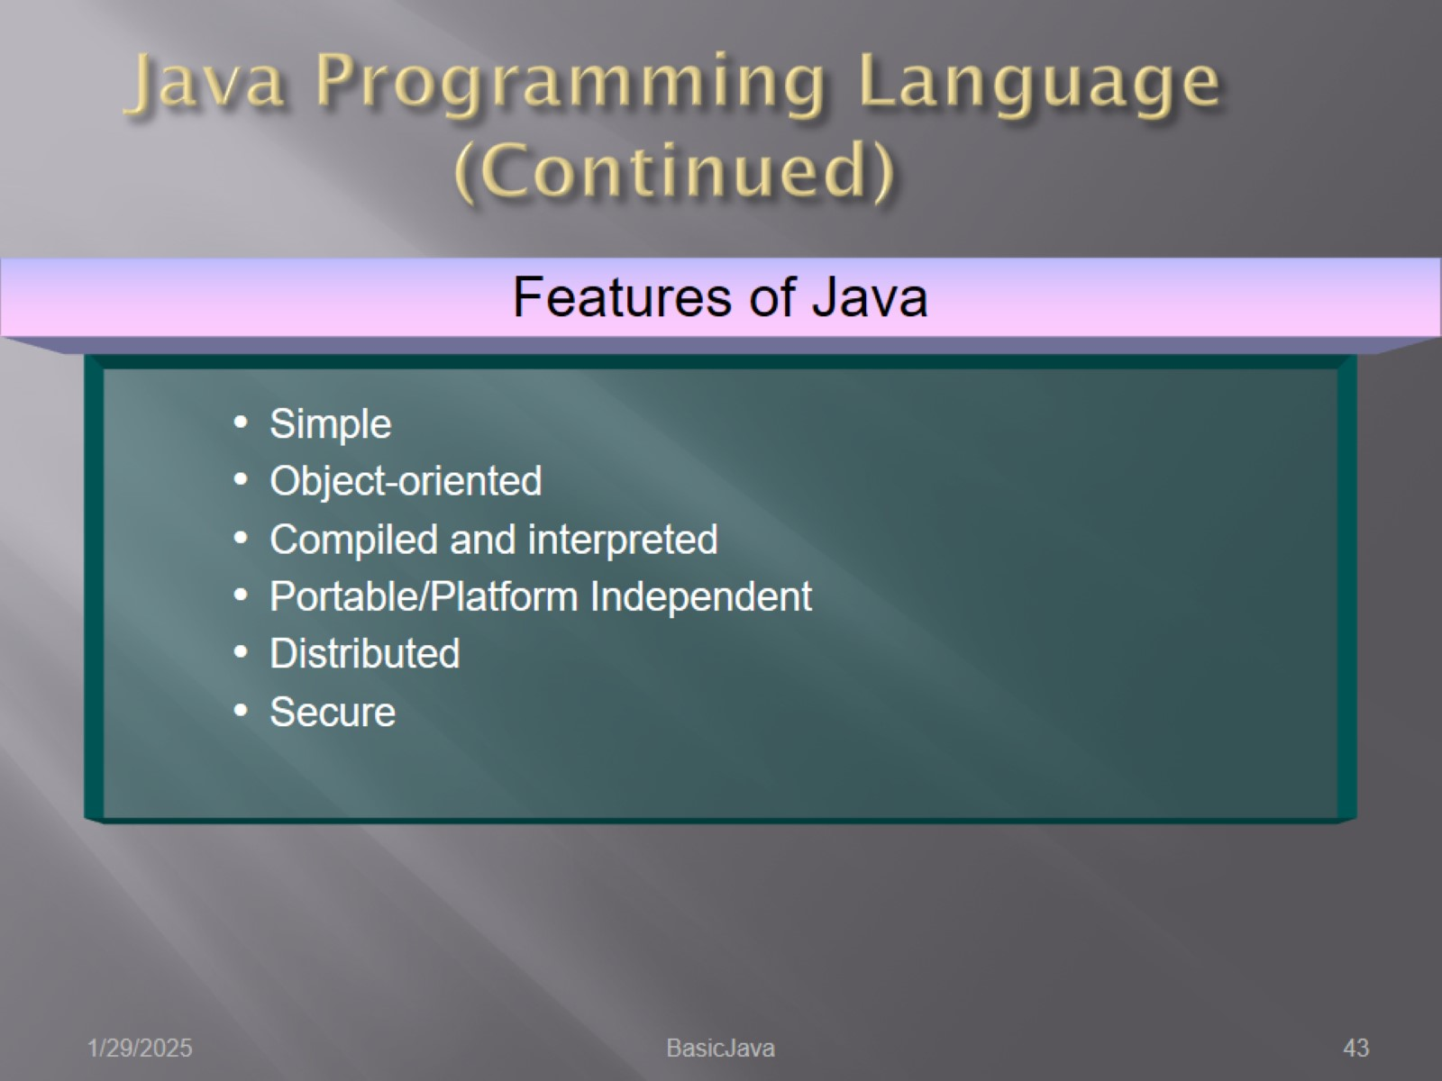
Java Programming Language (Continued)

Slide 44
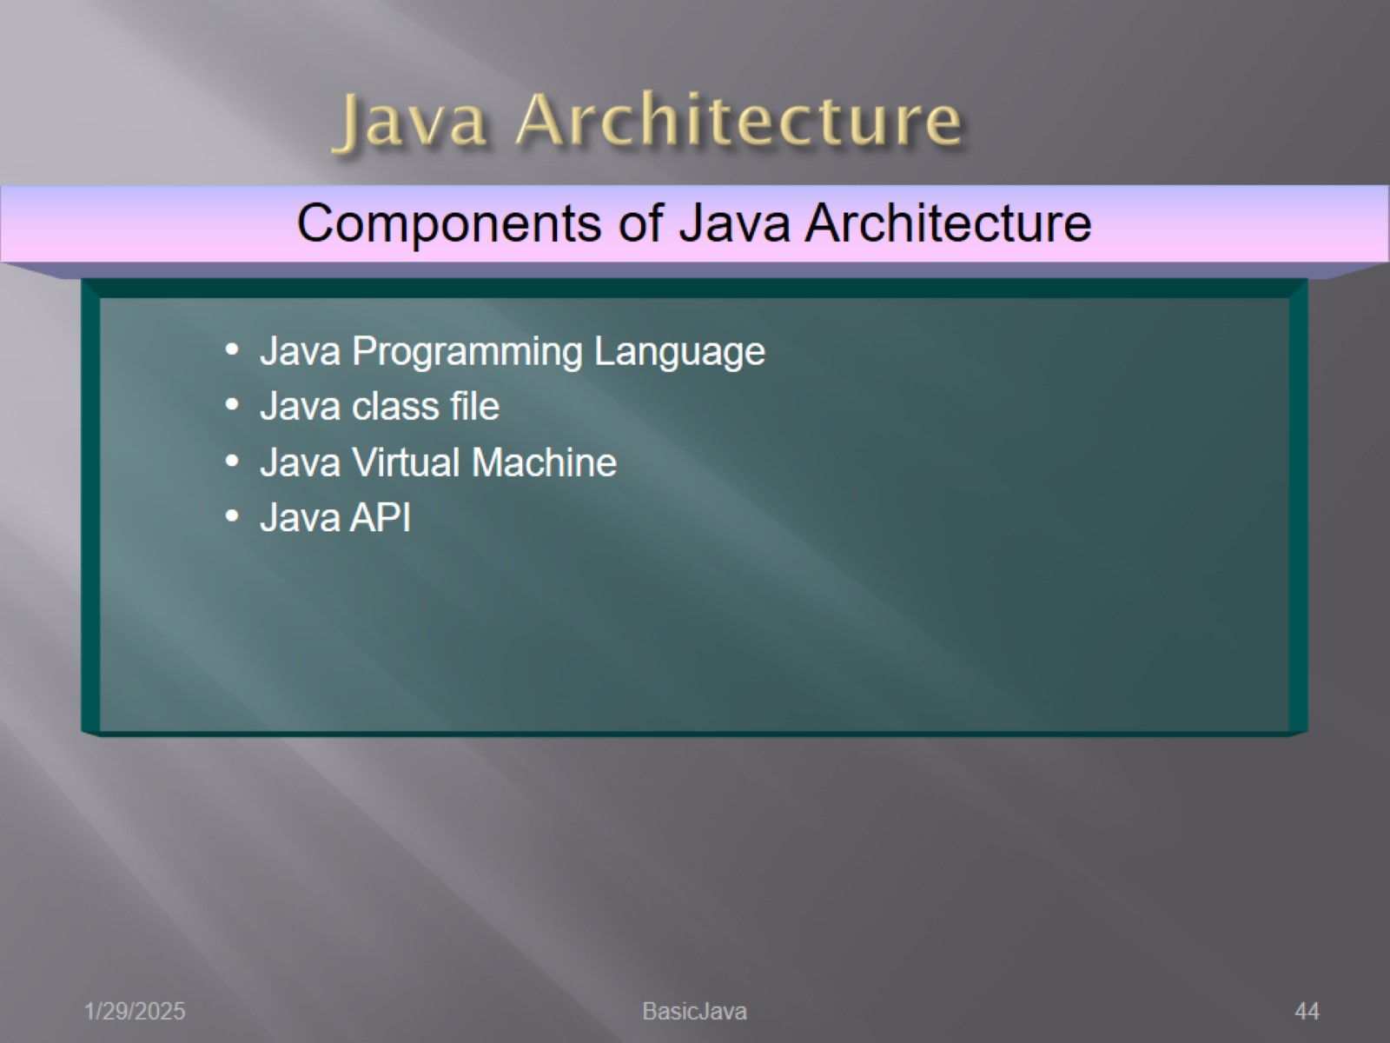
Java Architecture

Slide 45
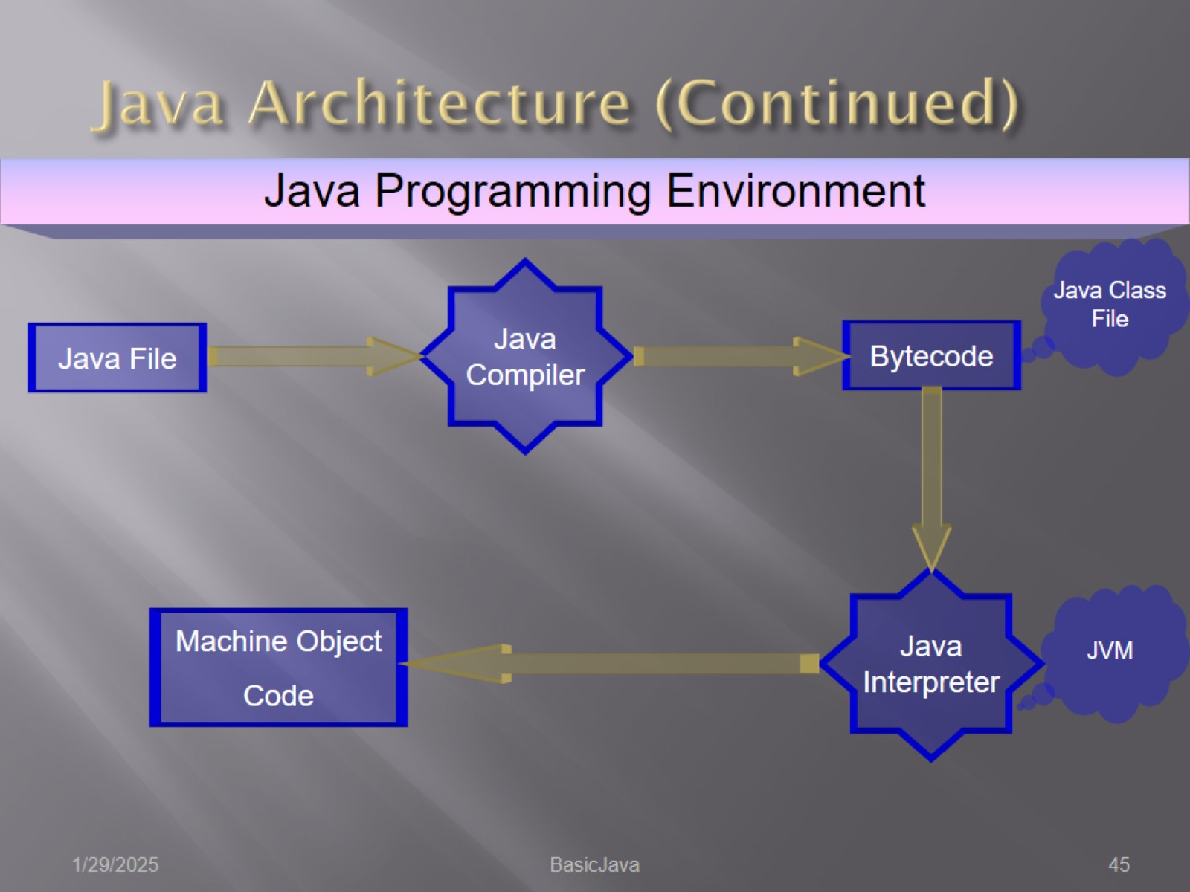
Java Architecture (Continued)

Slide 46
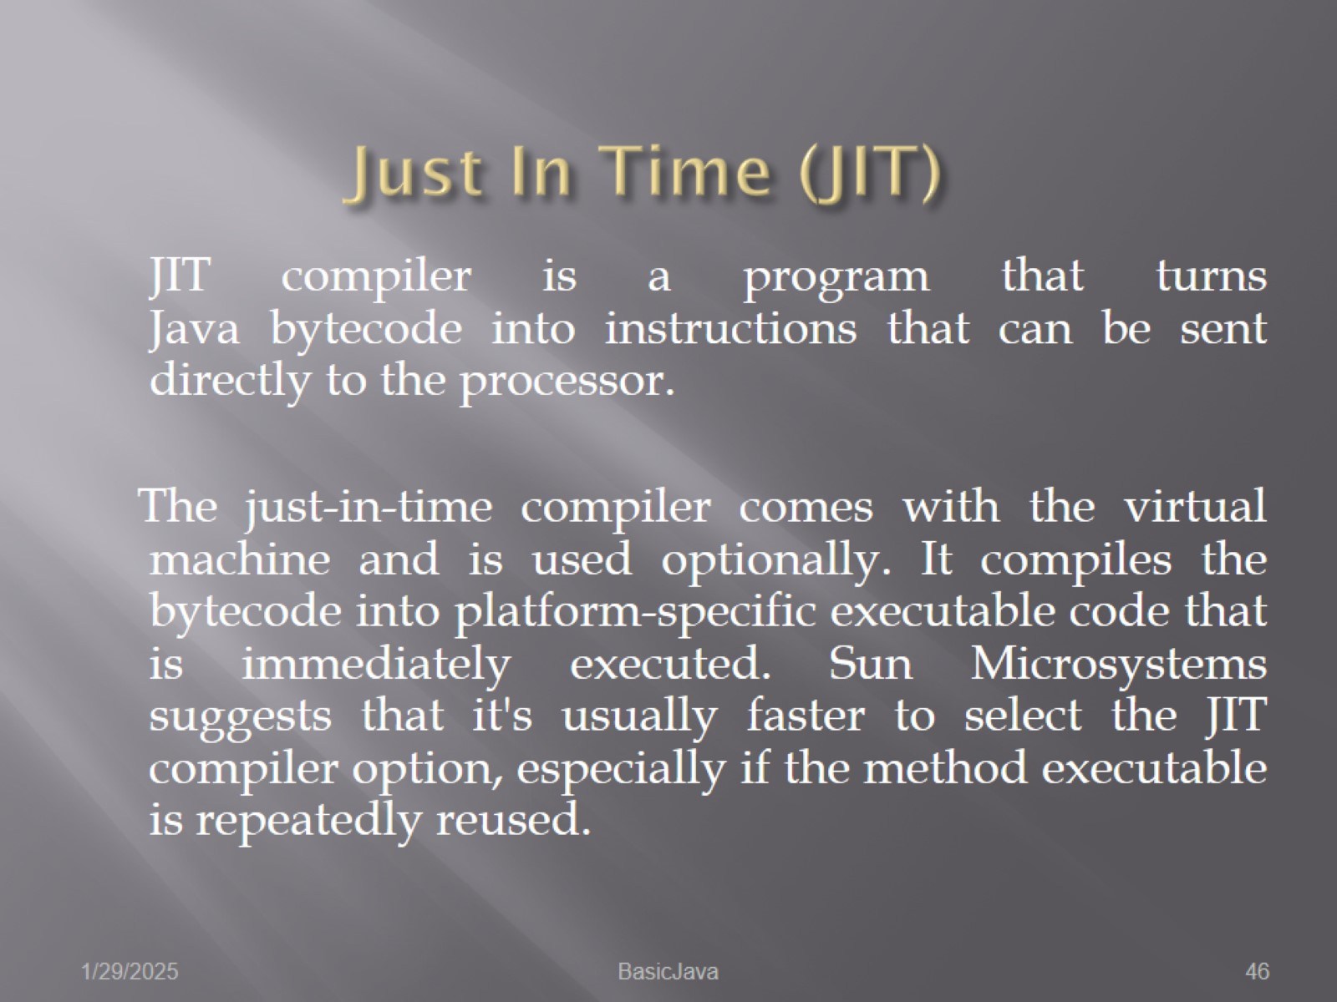
Just In Time (JIT)

Slide 47
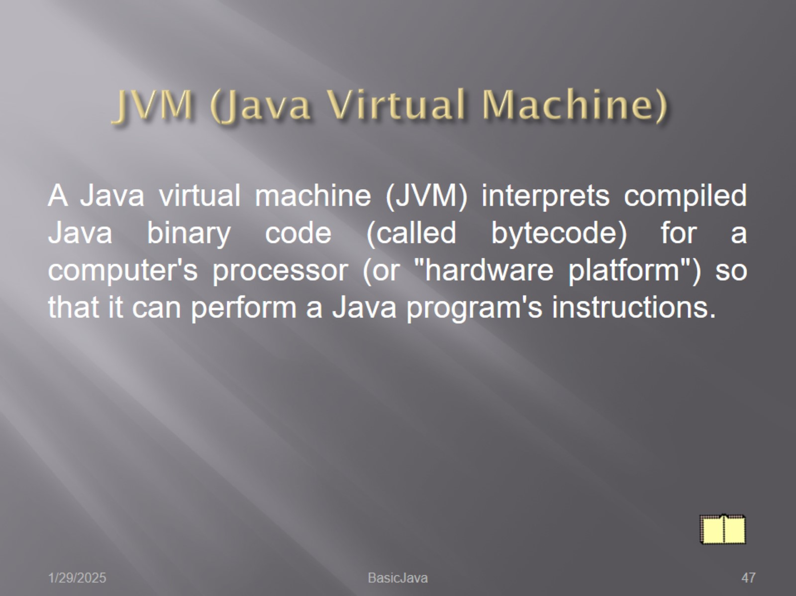
JVM (Java Virtual Machine)

Slide 48
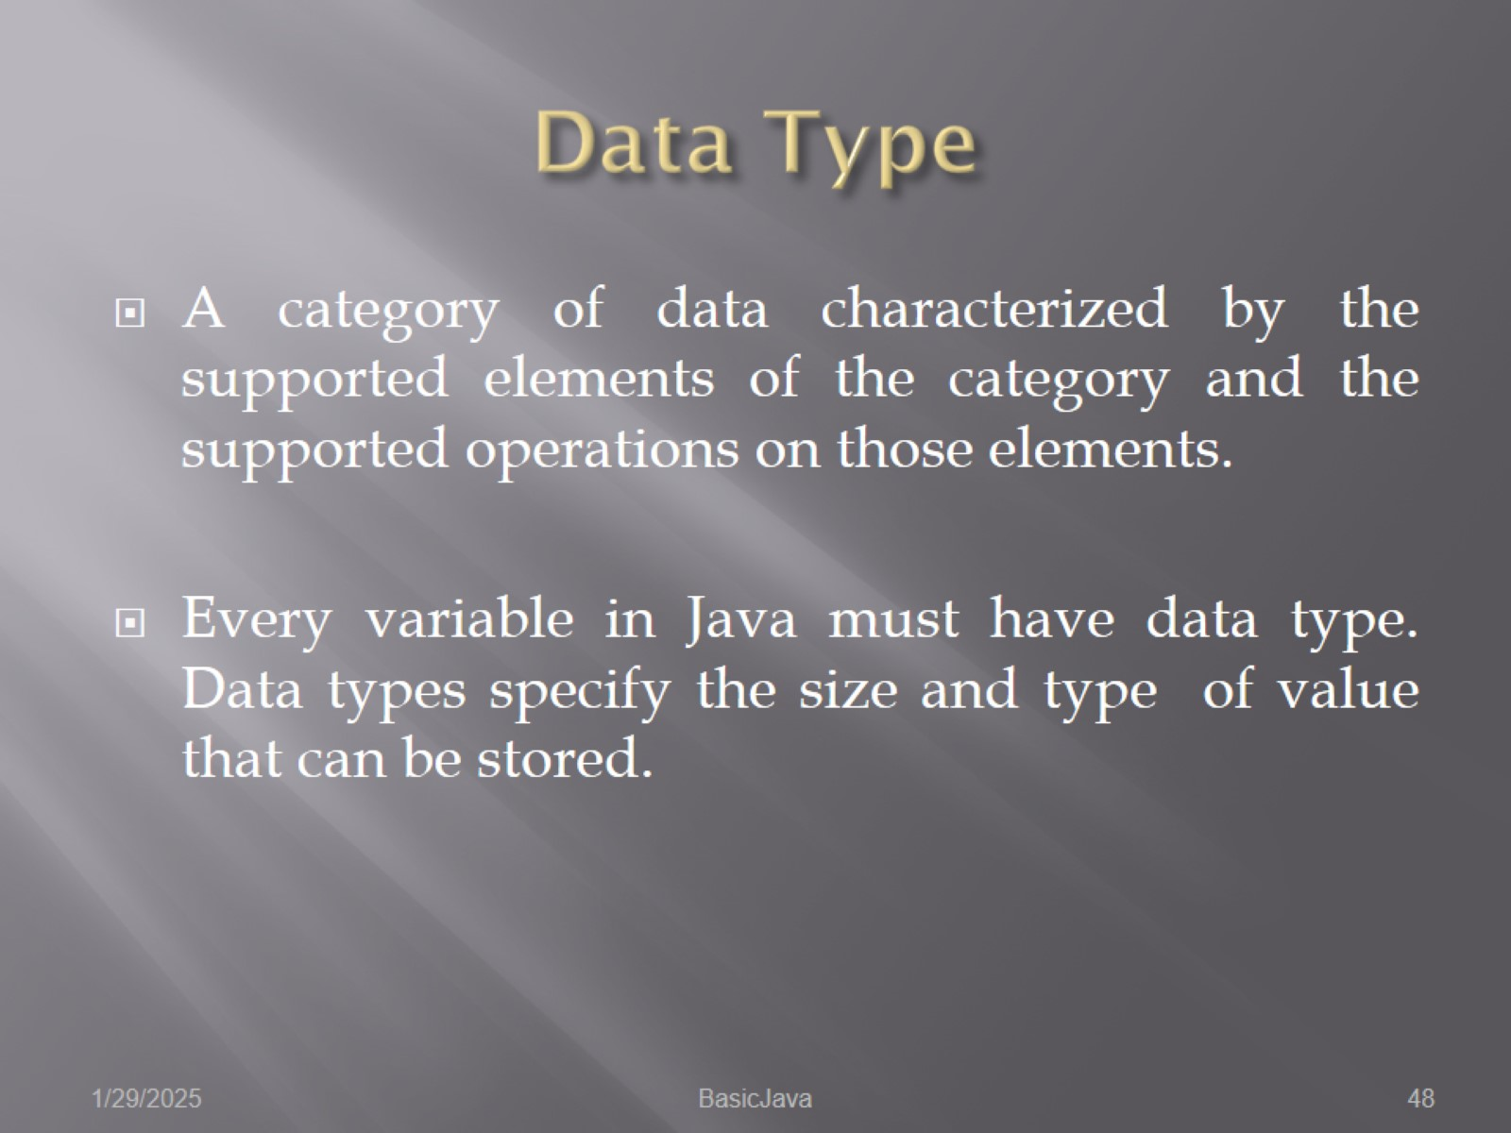
Data Type

Slide 49
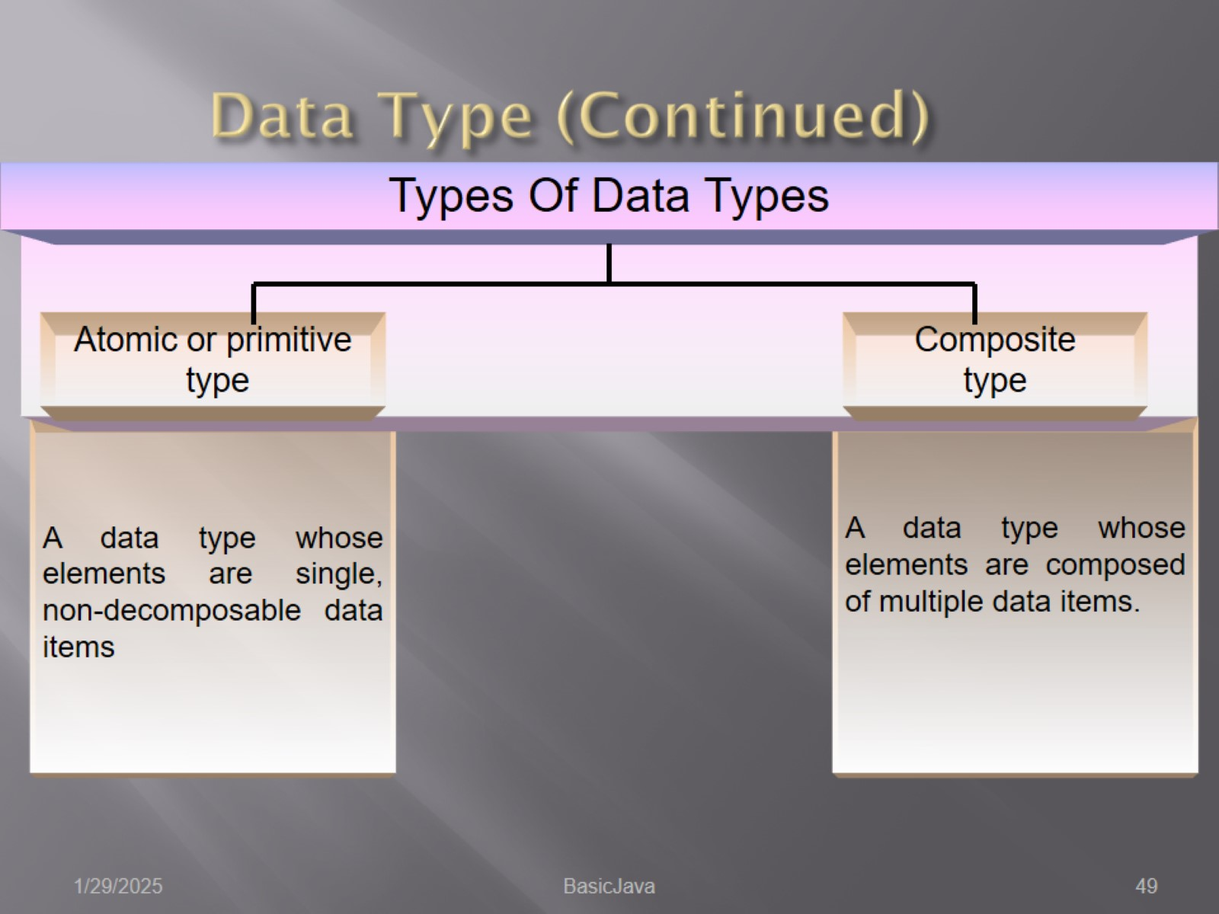
Data Type (Continued)

Slide 50
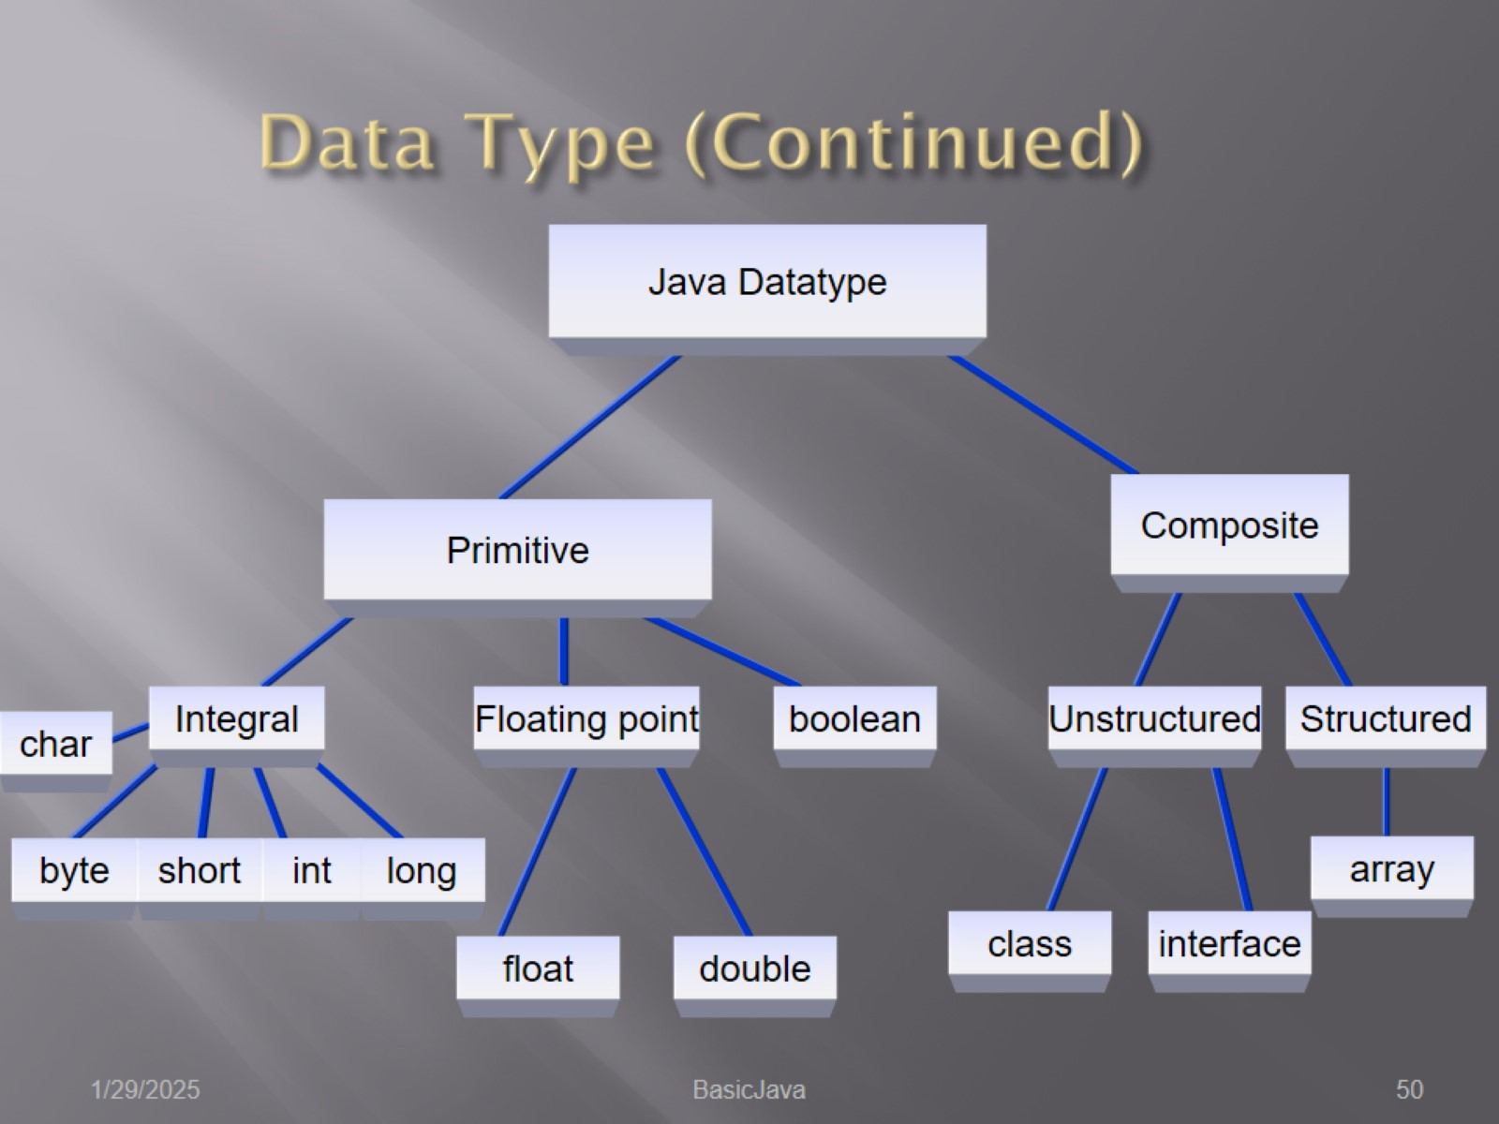
Data Type (Continued)

Slide 51
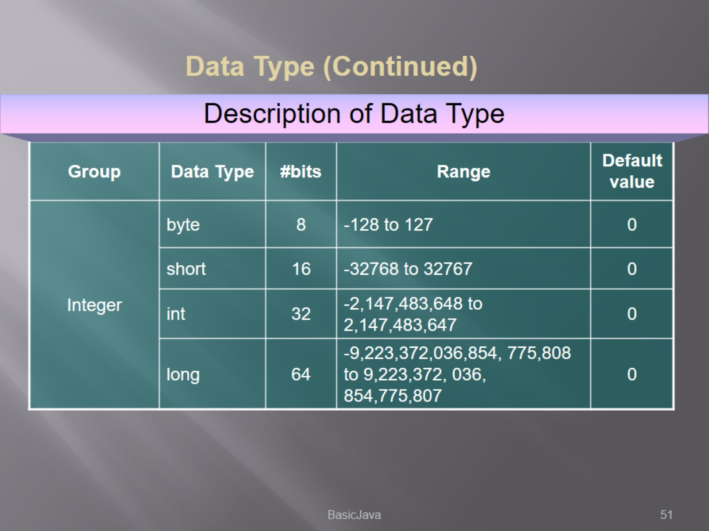

Slide 52


Slide 53


Slide 54


Slide 55


Slide 56


Slide 57


Slide 58

Variable Declaration

Slide 59

Variable Assignments

Slide 60

Operators

Slide 61

Types of Operators

Slide 62

Arithmetic Operators

Slide 63

Arithmetic Operators (Continued)

Slide 64

Arithmetic Operators (Continued)

Slide 65

Arithmetic Operators (Continued)

Slide 66

Comparison Operators

Slide 67

Boolean Operators

Slide 68

Boolean Operators (Continued)

Slide 69

Unary Operators

Slide 70


Slide 71

Class & Object Operators

Slide 72

Class & Object Operators (Continued)

Slide 73


Slide 74

Java Statement

Slide 75

Assignment Statement

Slide 76

Compound Statement

Slide 77

Control Statement

Slide 78

Conditional Statement - if Statement

Slide 79

Conditional Statement - if Statement (Continued)

Slide 80

Conditional Statement - switch Statement

Slide 81

Repeat Statement - for Statement

Slide 82

Repeat Statement - for Statement (Continued)

Slide 83

Repeat Statement - for Statement (Continued)

Slide 84

Repeat Statement - while Statement

Slide 85

Repeat Statement - while Statement (Continued)

Slide 86

Repeat Statement – do - while Statement

Slide 87

Branch Statement - break Statement

Slide 88

Branch Statement - break Statement

Slide 89

Branch Statement – continue Statement

Slide 90

Branch Statement – continue Statement (Continued)

Slide 91

Branch Statement – continue Statement (Continued)

Slide 92

Branch Statement – return Statement

Slide 93

Arrays

Slide 94

Arrays (contd.)

Slide 95

Arrays (contd.)

Slide 96

Arrays (contd.)

Slide 97

Arrays (contd.)

Slide 98

Arrays (contd.)

Slide 99

Choose The Correct Array Declaration

Slide 100

Structure of Java Application

Slide 101

Structure of Java Application (Continued)

Slide 102

Structure of Java Application (Continued)

Slide 103

Structure of Java Application (Continued)

Slide 104

Structure of Java Application (Continued)

Slide 105

Structure of Java Application (Continued)

Slide 106

Structure of Java Application (Continued)

Slide 107

Structure of Java Application (Continued)

Slide 108

Structure of Java Application (Continued)

Slide 109

Structure of Java Application (Continued)

Slide 110

Structure of Java Application (Continued)

Slide 111


Slide 112


Slide 113


Slide 114


Slide 115


Slide 116


Slide 117


Slide 118


Slide 119


Slide 120


Slide 121


Slide 122


Slide 123


Slide 124


Slide 125


Slide 126


Slide 127


Slide 128

Test Your Understanding

Slide 129

Test Your Understanding (Contd.)

Slide 130

Exercise No. 1

Slide 131

Exercise No. 2

Slide 132

Exercise No. 3

Slide 133

References

Slide 134


